Slide 1
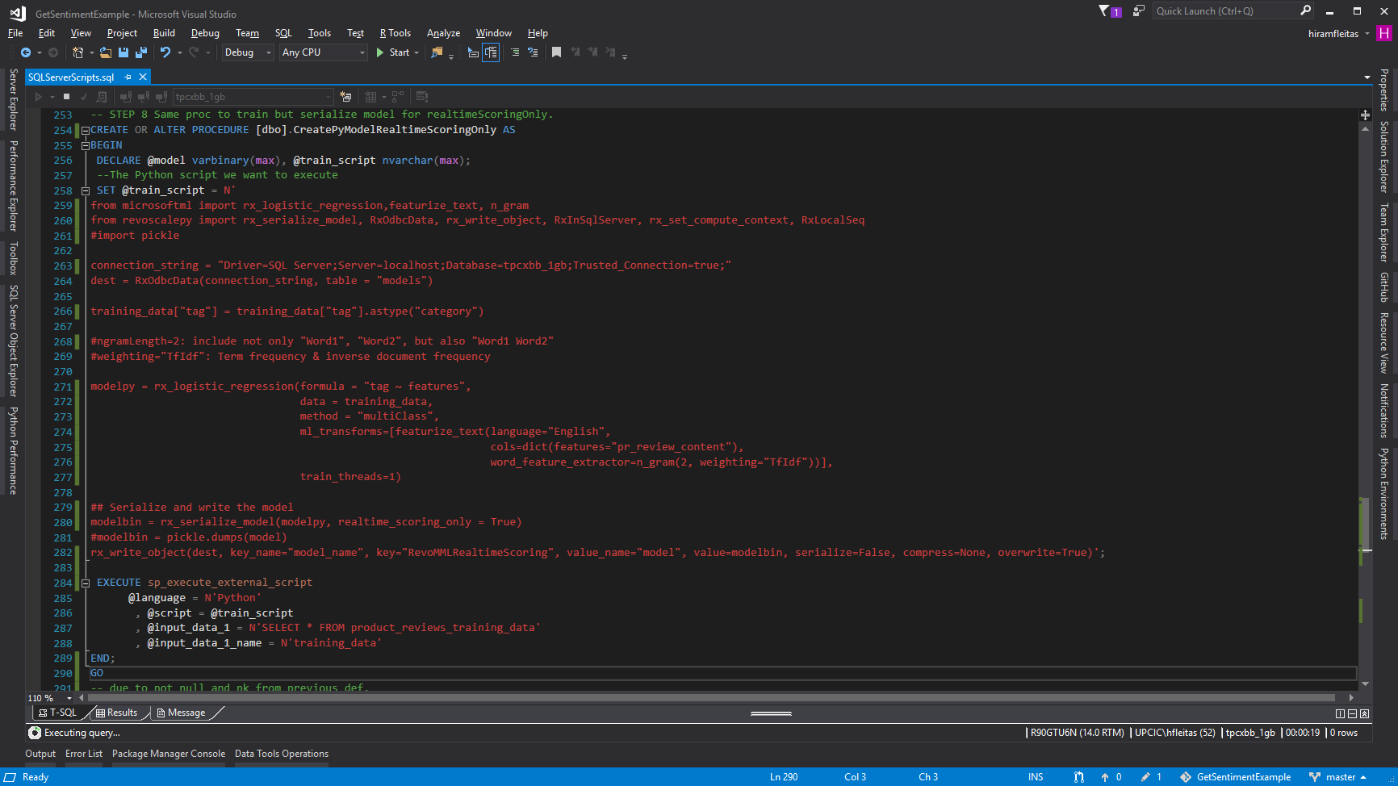


Real-time Sentiment Prediction
in SQL Server
Hiram Fleitas
Fleitas Arts
Public: goo.gl/BqfYSi

Slide 2
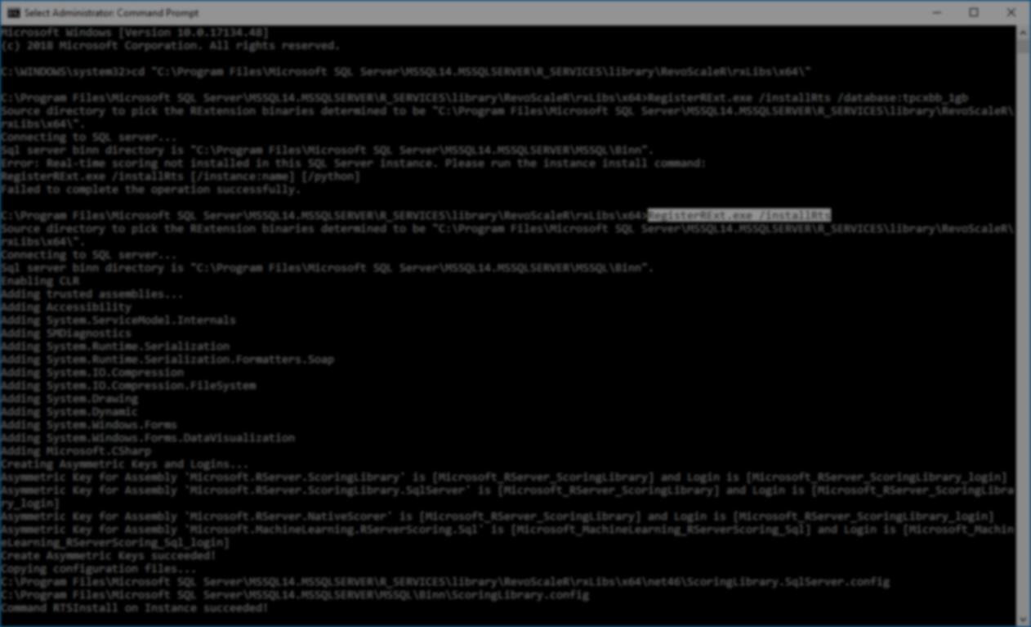

Please silence cell phones

Slide 3


Slide 4
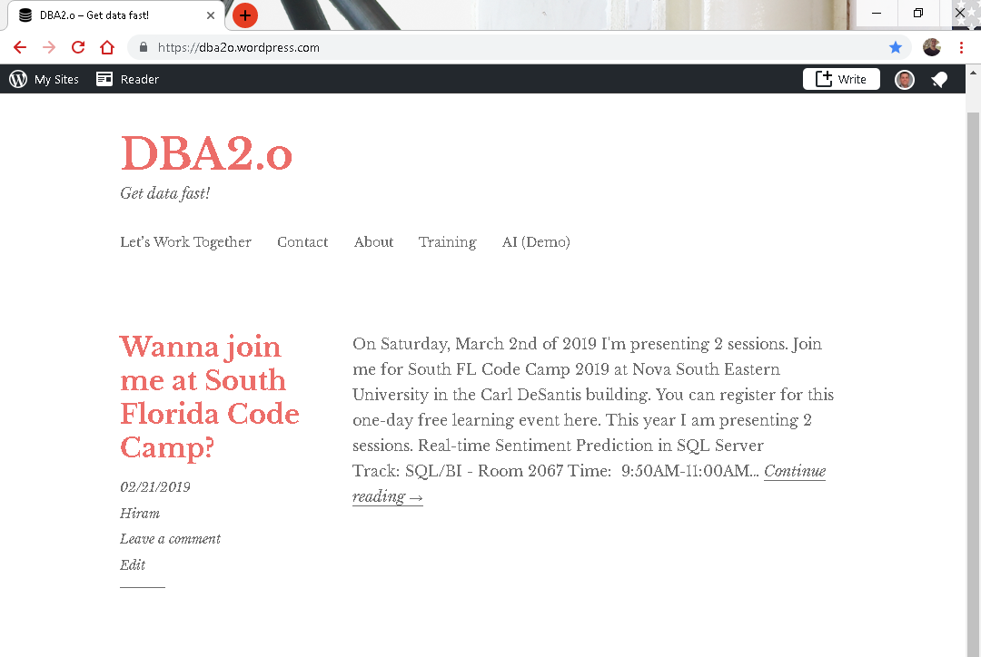

Slide 5
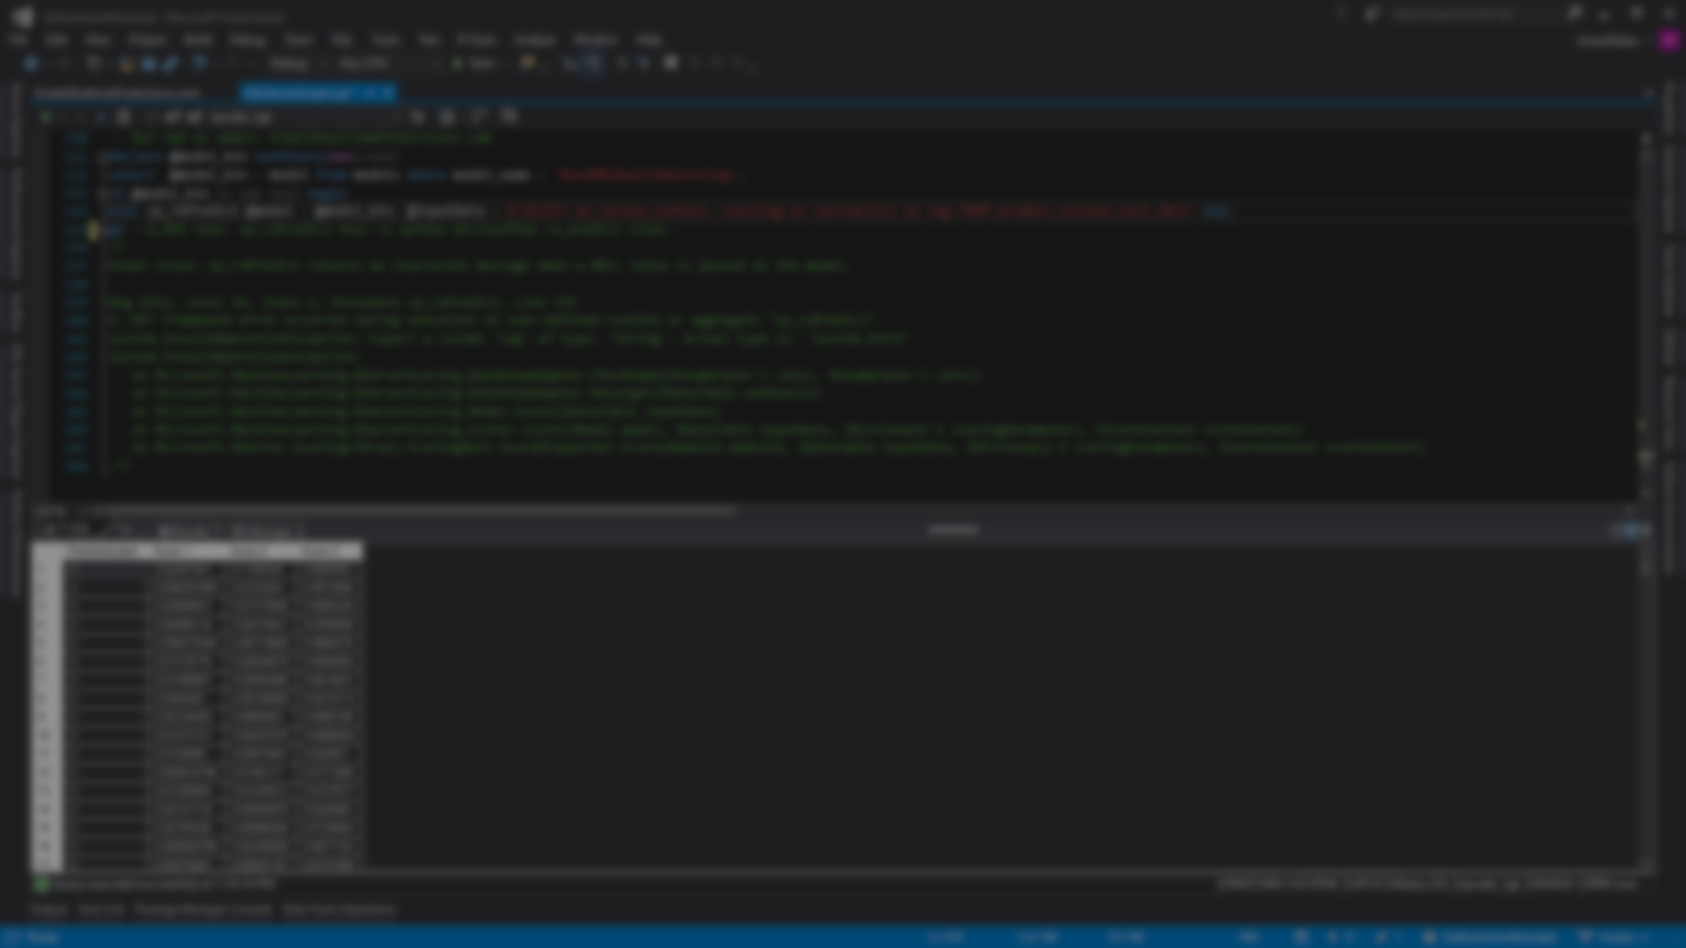

Session evaluations
This is the link:
bit.ly/30JwGlV
Your feedback is very important.
Submit your feedback by the end of this presentation.

Slide 6




BIO
Father
Principal DB Architect
*SQL Server since 1999
Developer since 1995
IT Professional
USCG Auxiliary Staff Officer
Microsoft Certified Professional
Hiram Fleitas
Principal Database Architect @UPCIC
FUN
Construction & Family
/HiramFleitas
/hfleitas
@HiramFleitas
hiramfleitas@hotmail.com
HiramFleitas
dba2o.wordpress.com

Slide 7
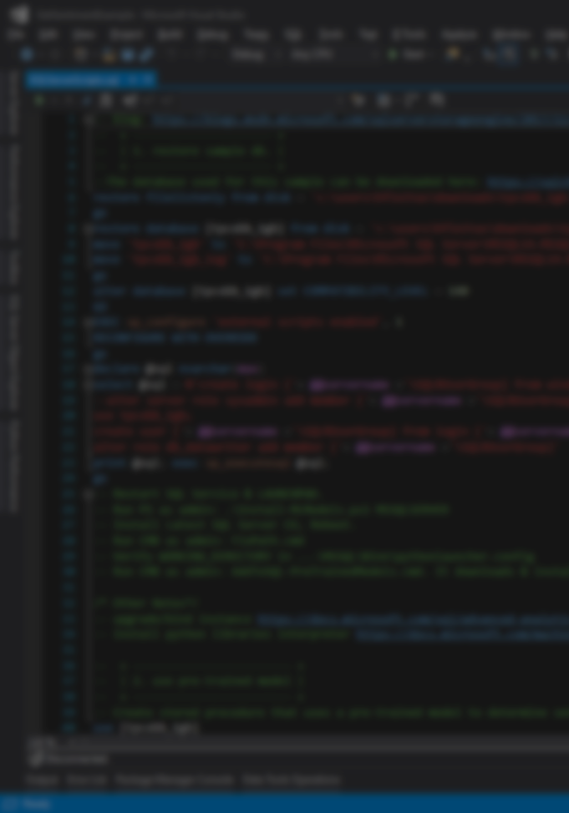
Agenda
Add ML Features
Grant Access
Config
Install Pre-Trained & Open Source ML Models (DNN)
Code in Python and T-SQL
Python Profiling
Real-time scoring
Review Sentiment Results
Resources

Slide 8

DEMO
SQL Server
Machine Learning & AI

Slide 9
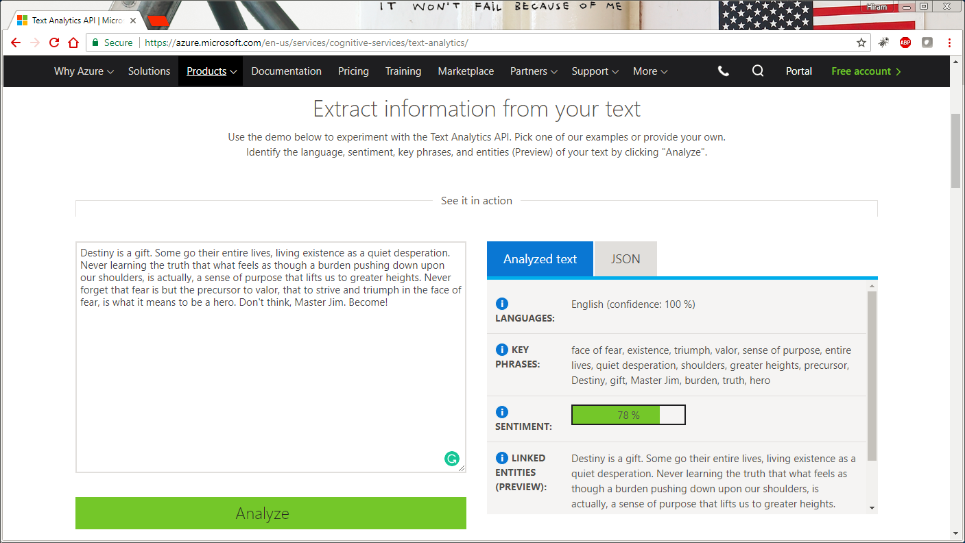

Slide 10
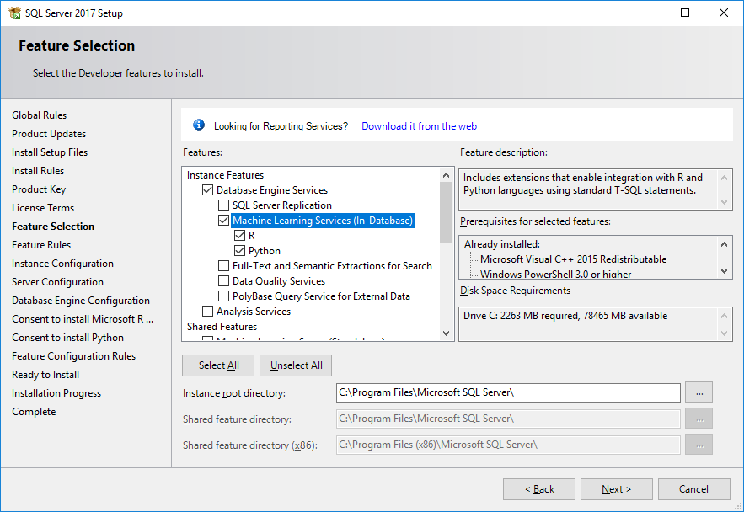

Slide 11
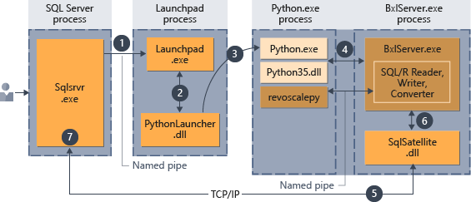
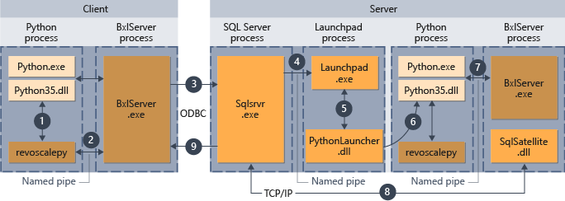

Slide 12
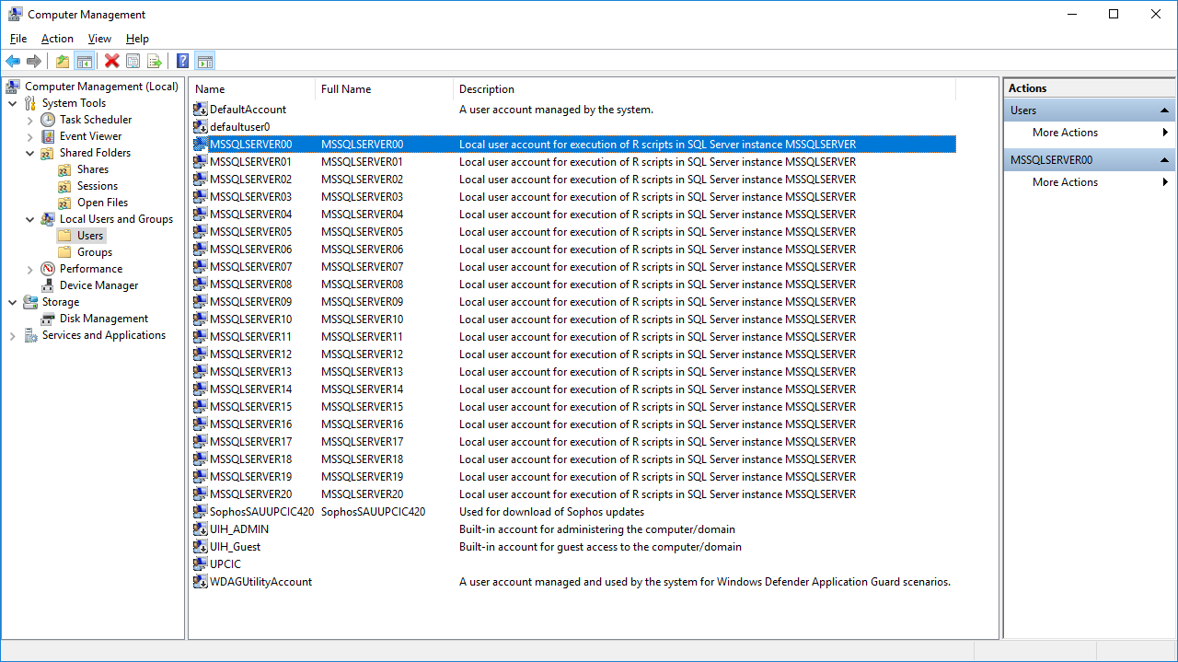

Slide 13
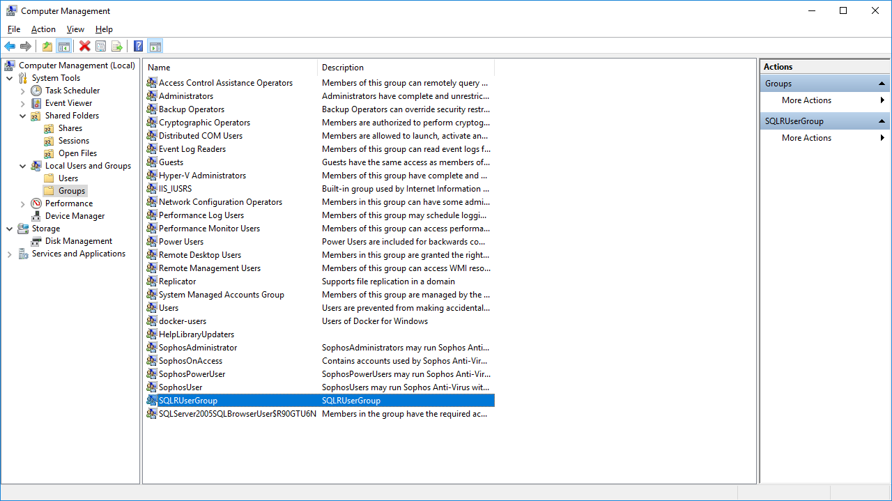
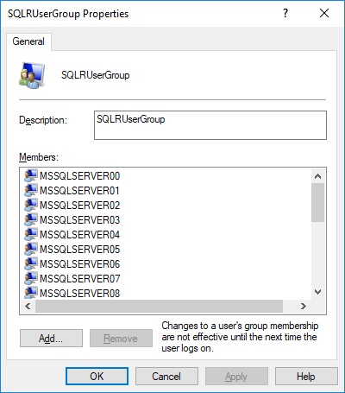

Slide 14
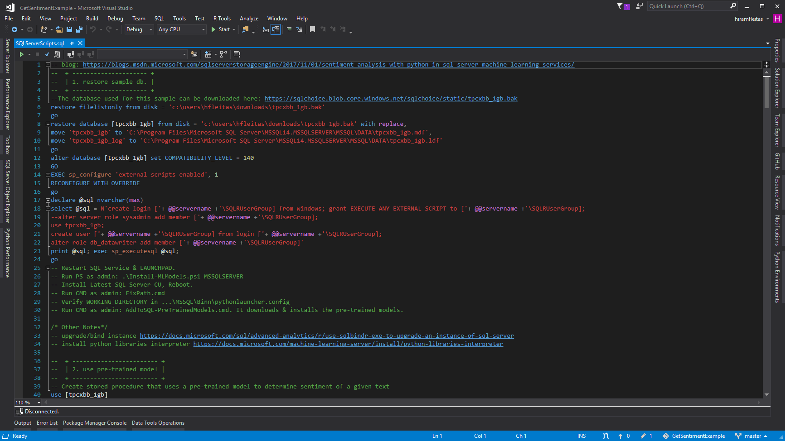

Slide 15
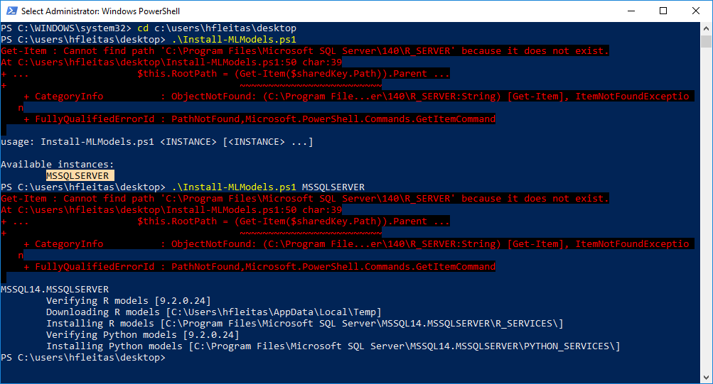

Slide 16
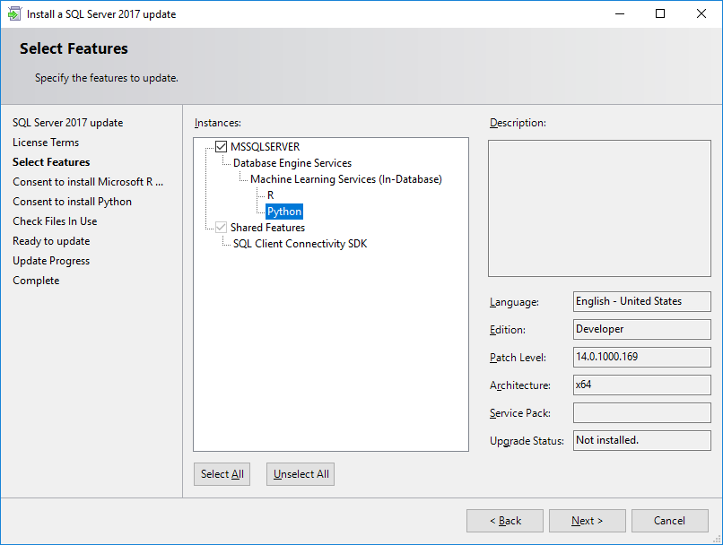

Slide 17
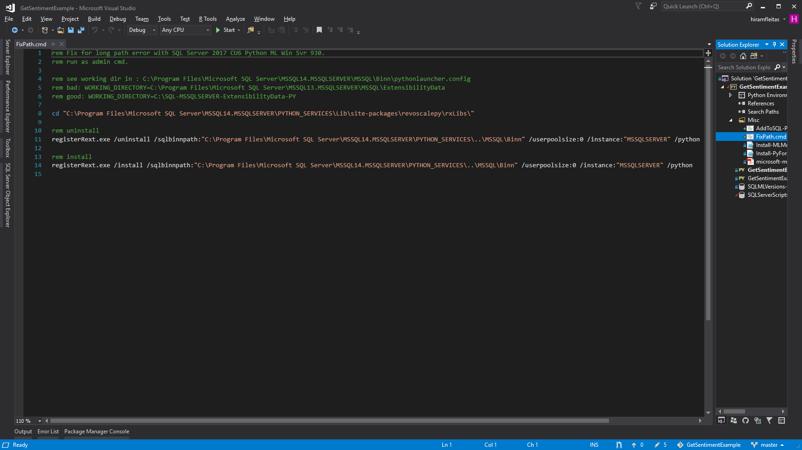

Slide 18
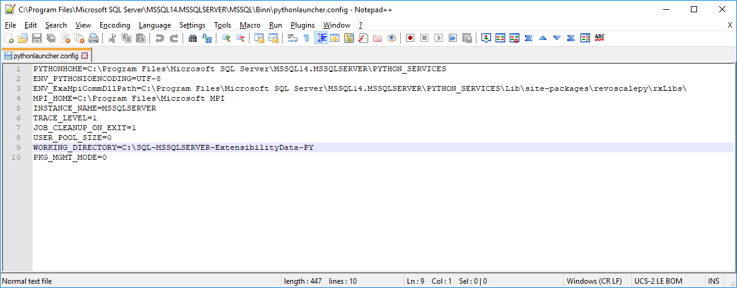

Slide 19
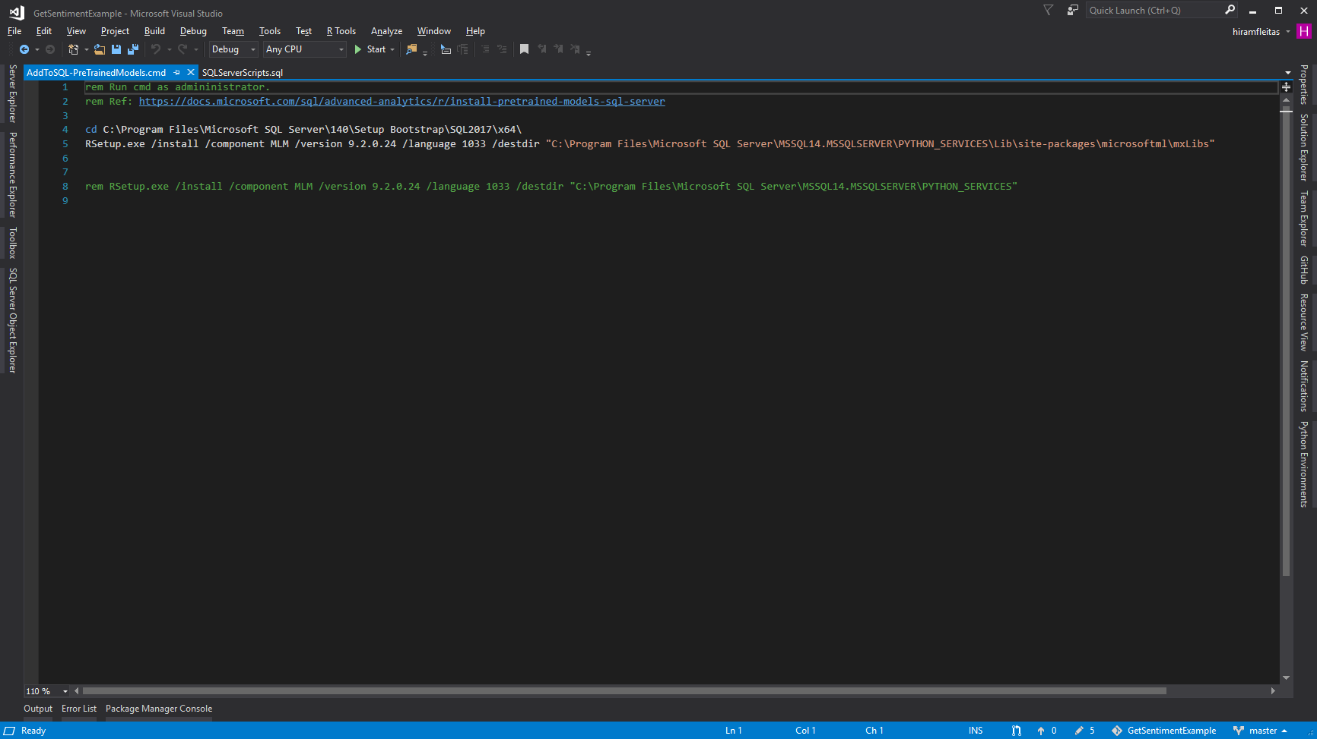

Slide 20
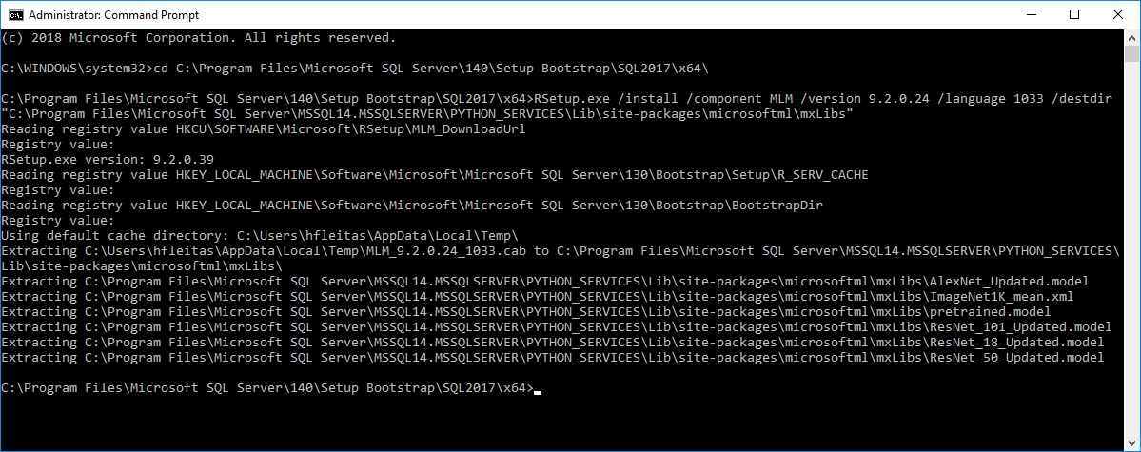

Slide 21
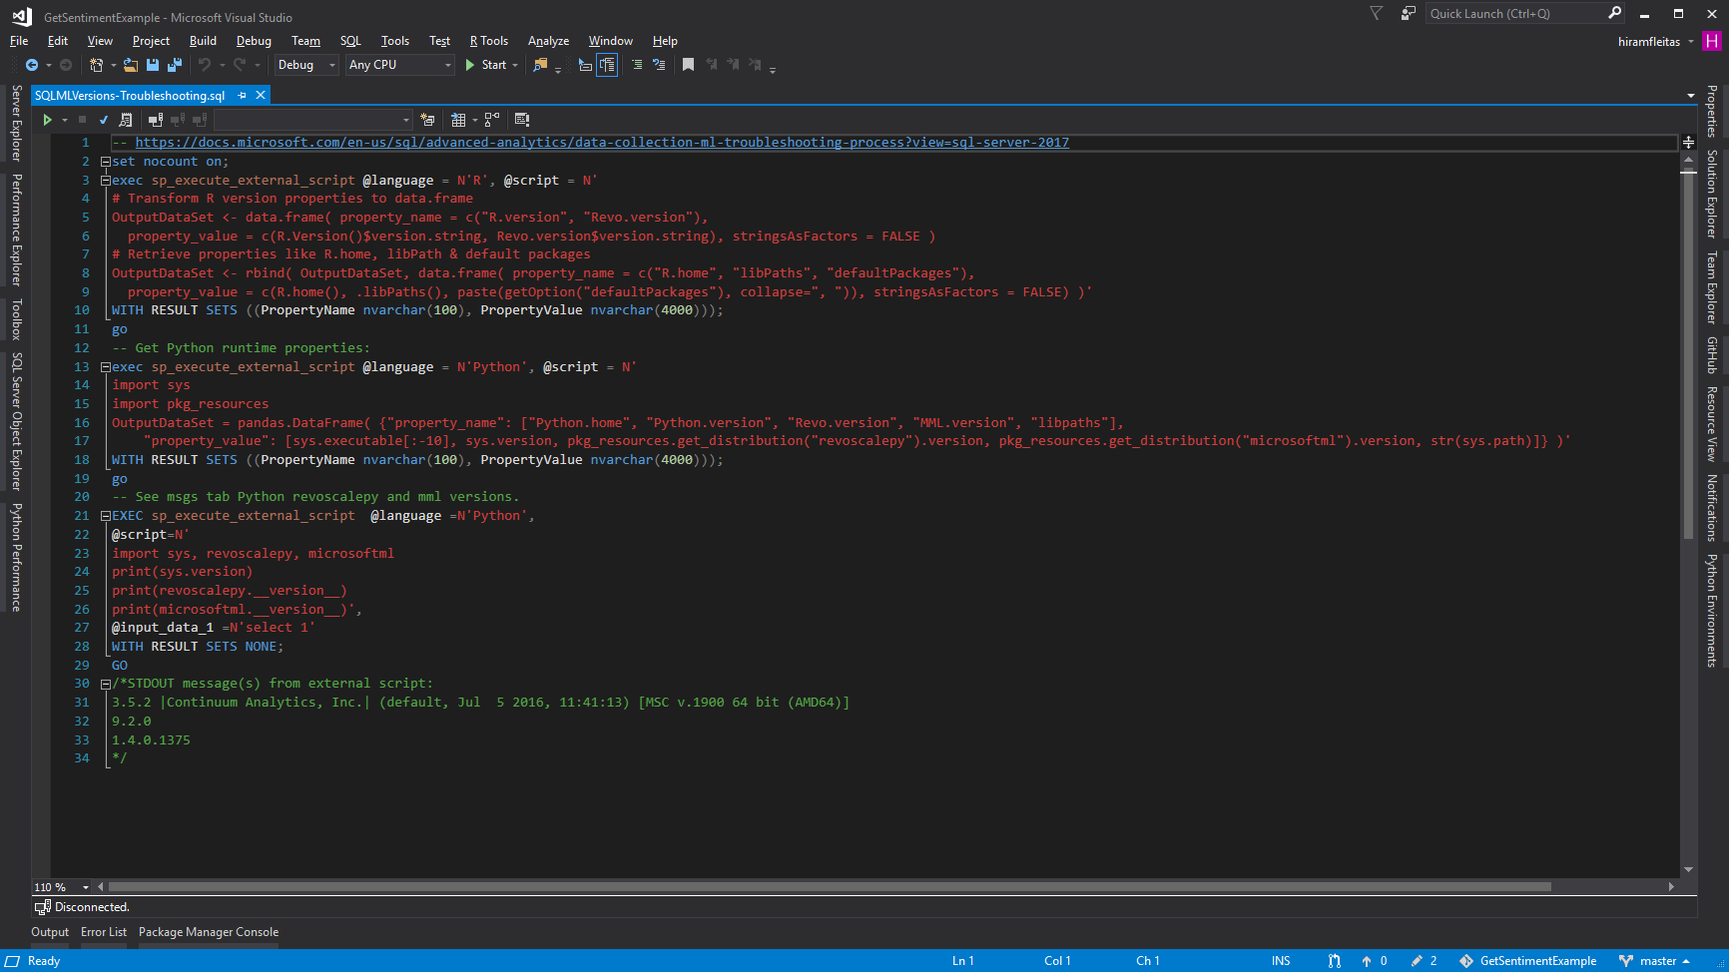

Slide 22
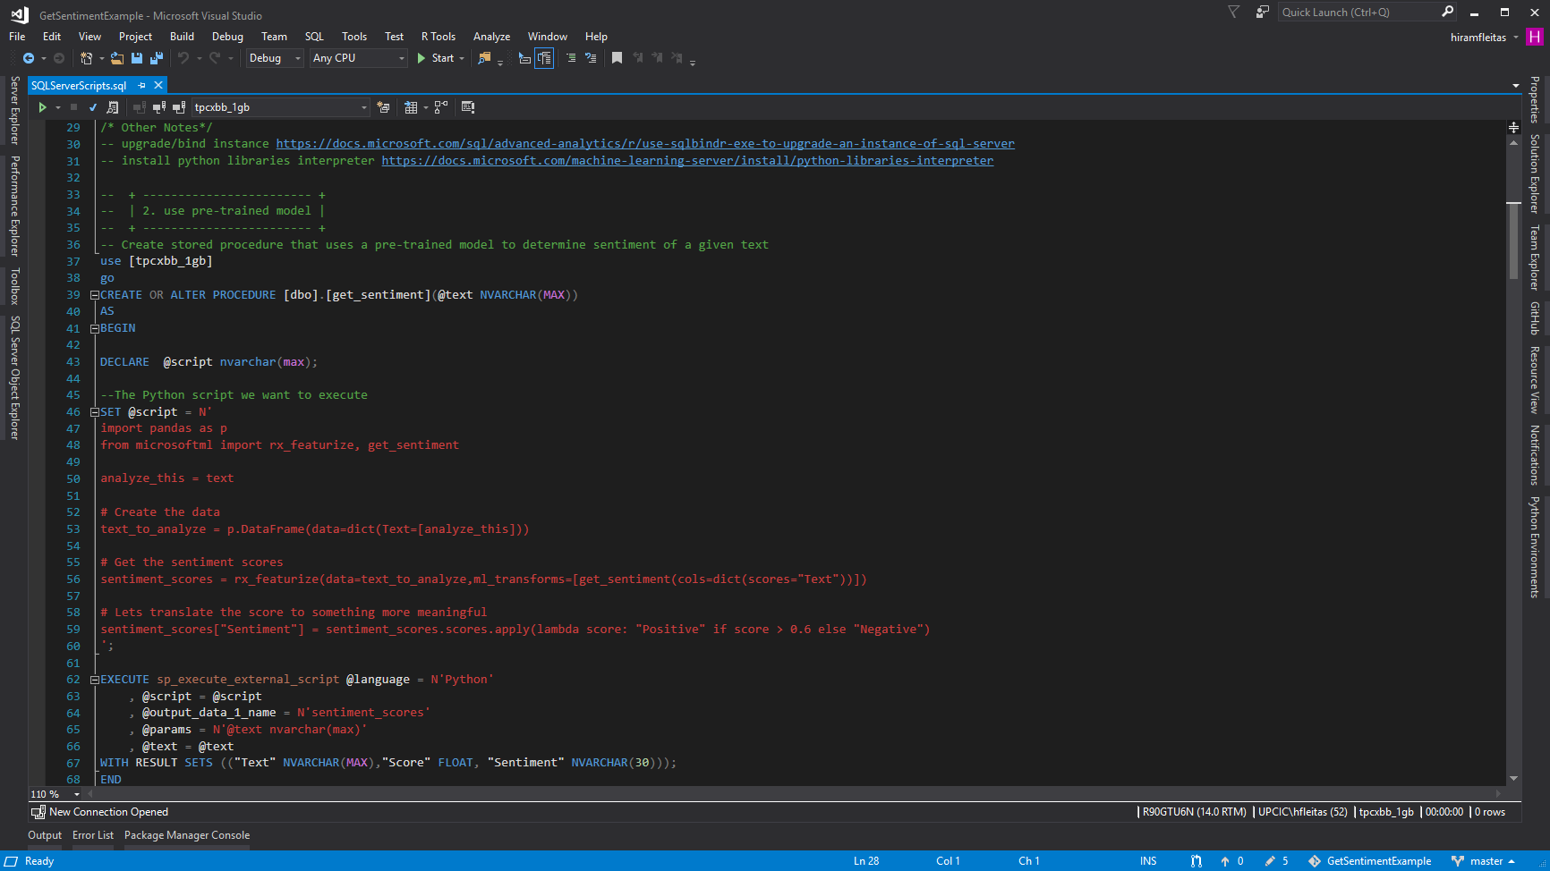

Slide 23
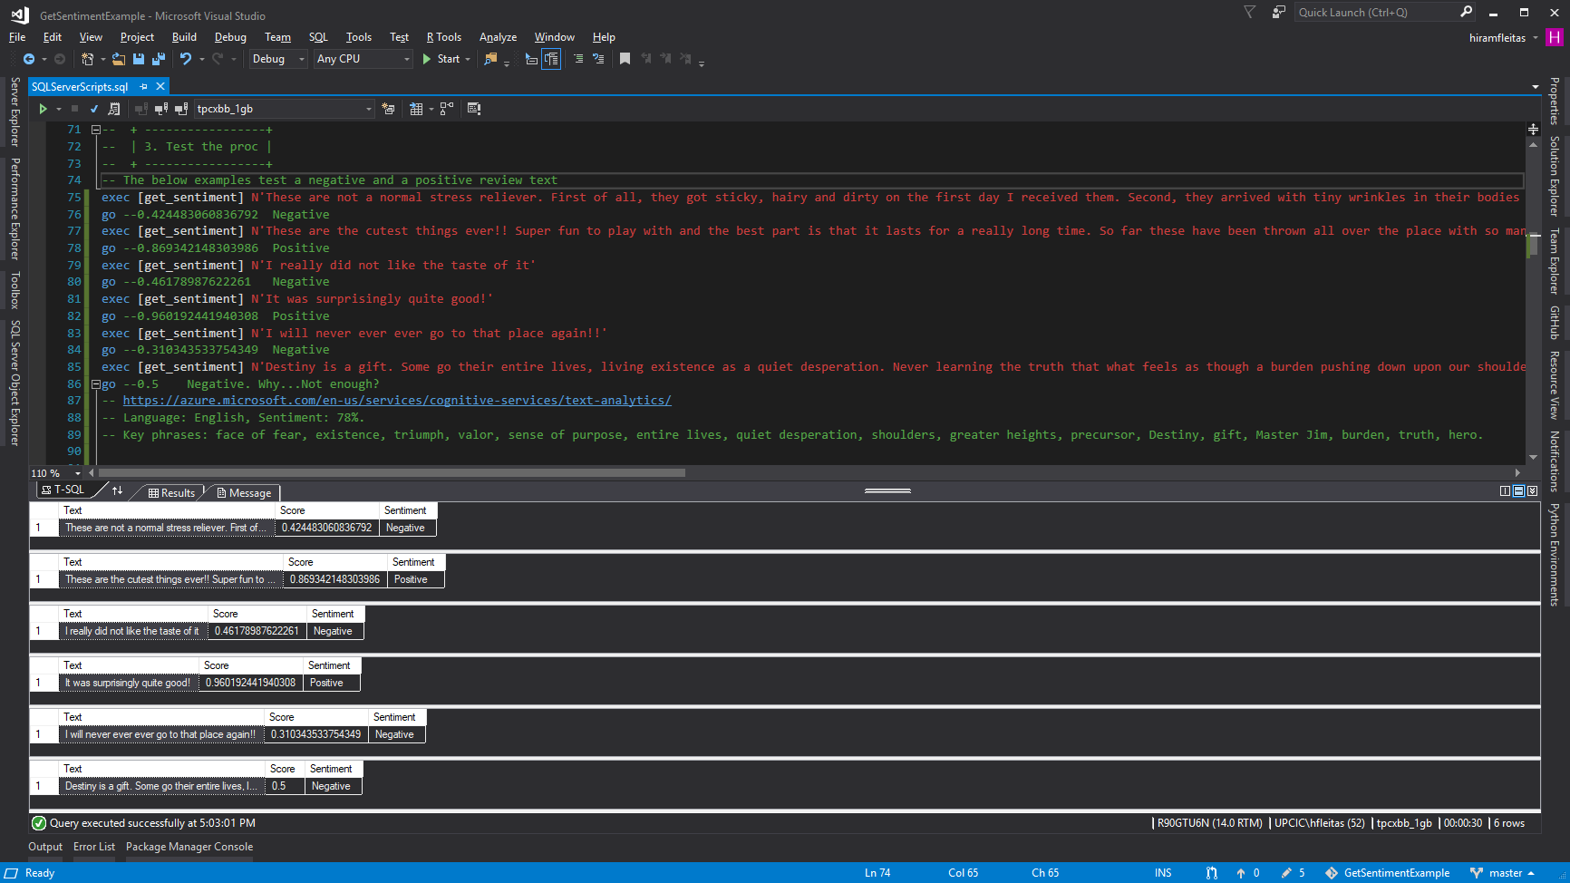

Slide 24
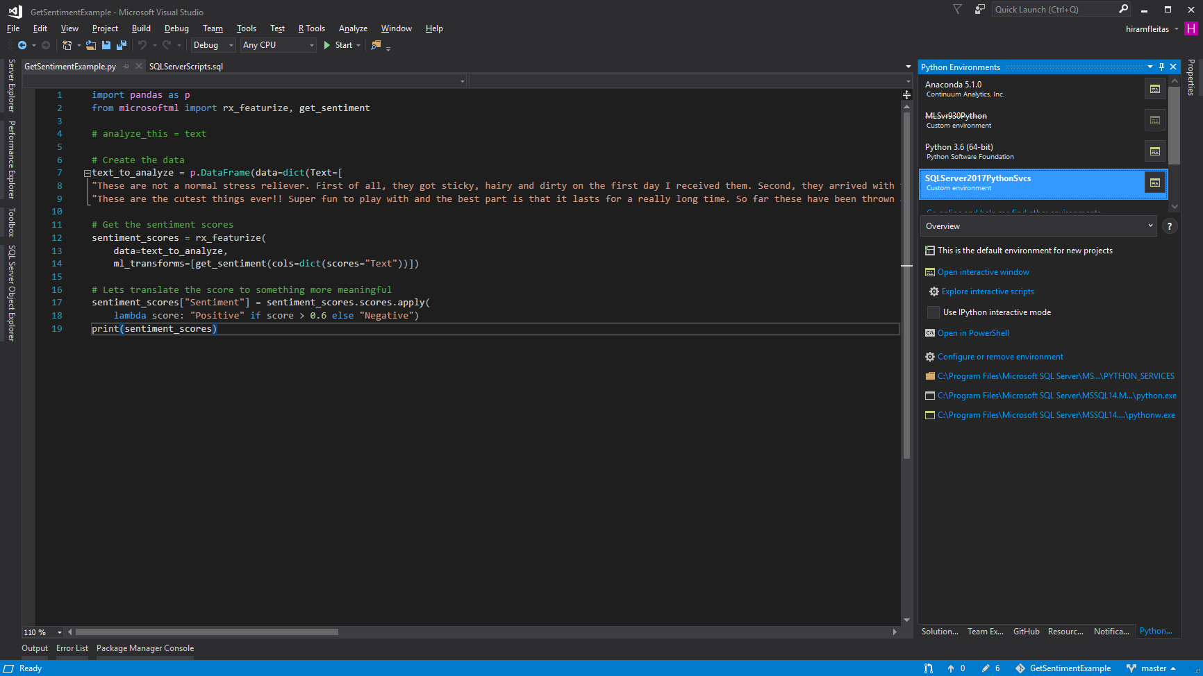
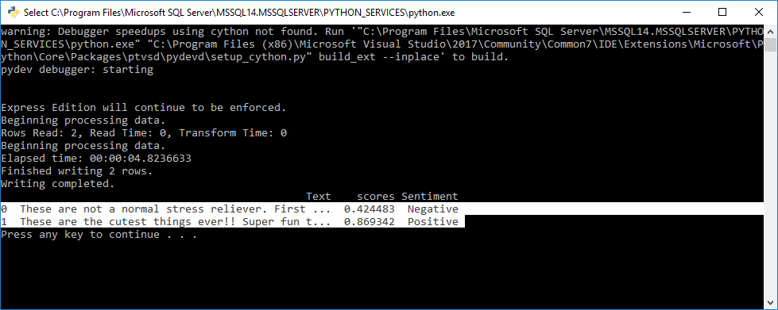

Slide 25
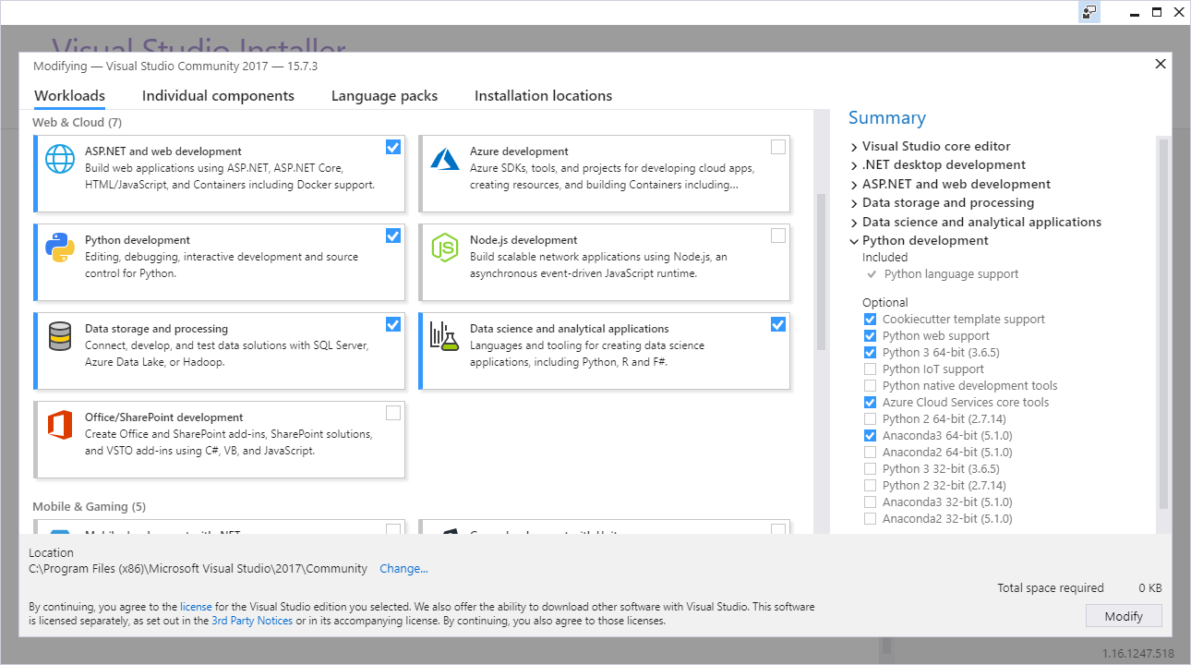

Slide 26
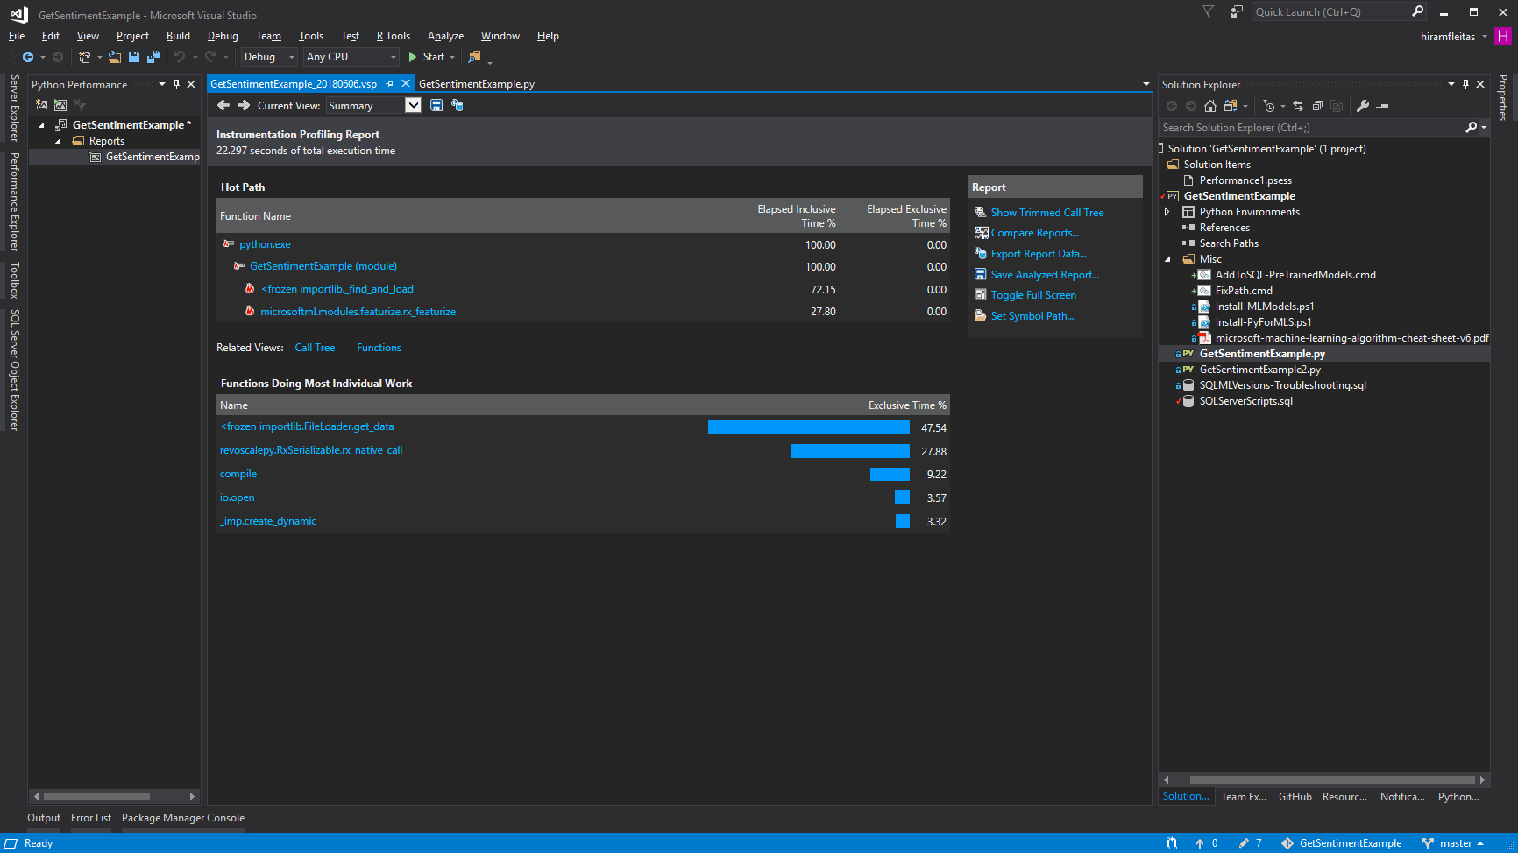
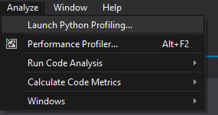

Slide 27
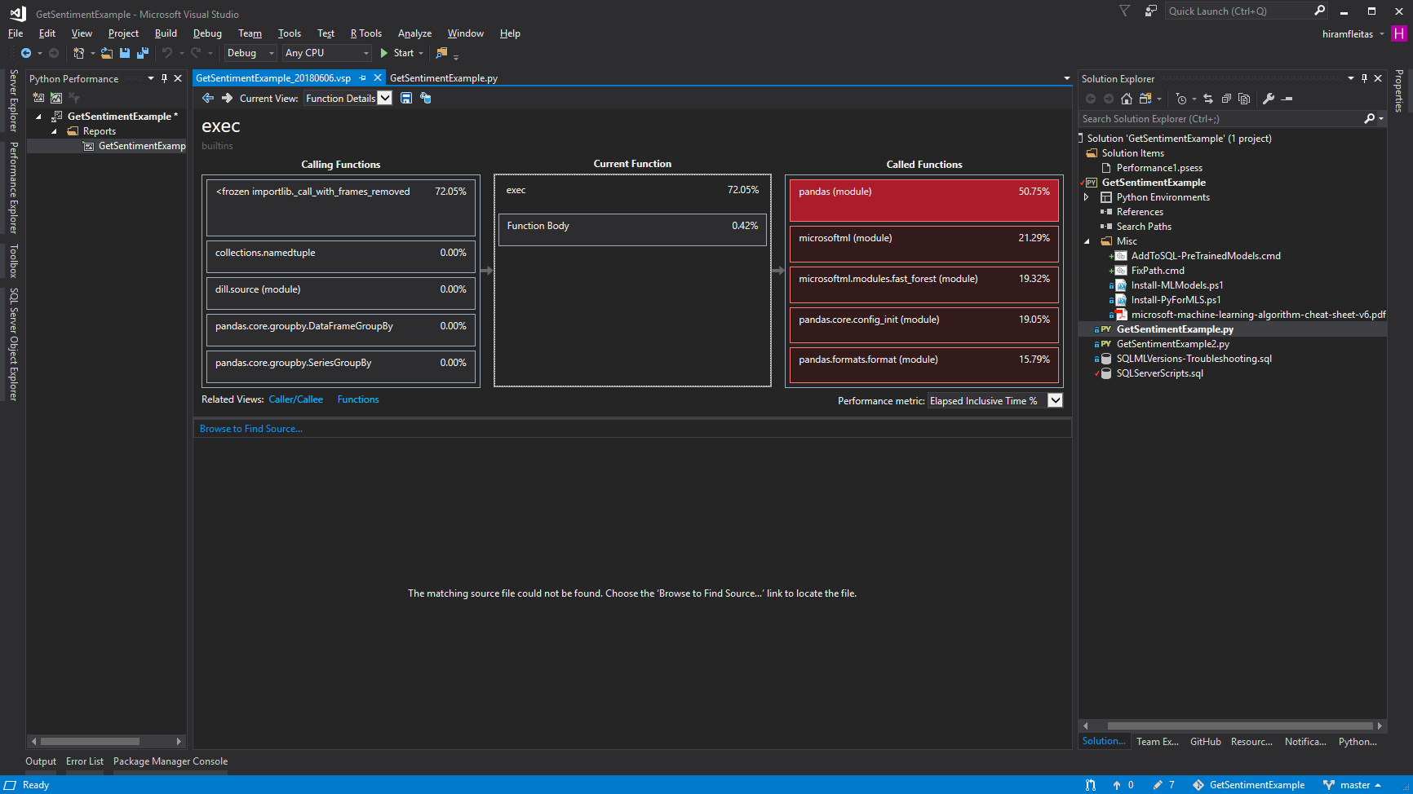

Slide 28
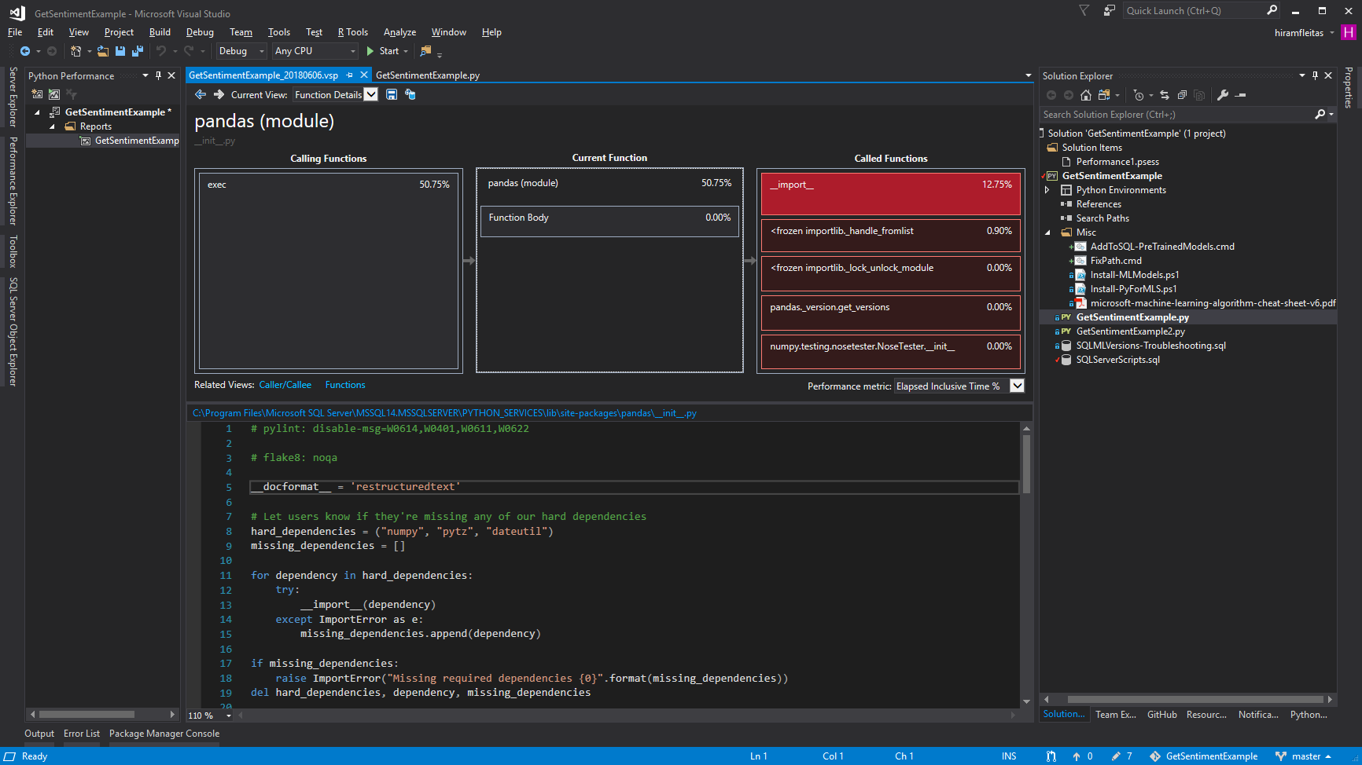

Slide 29
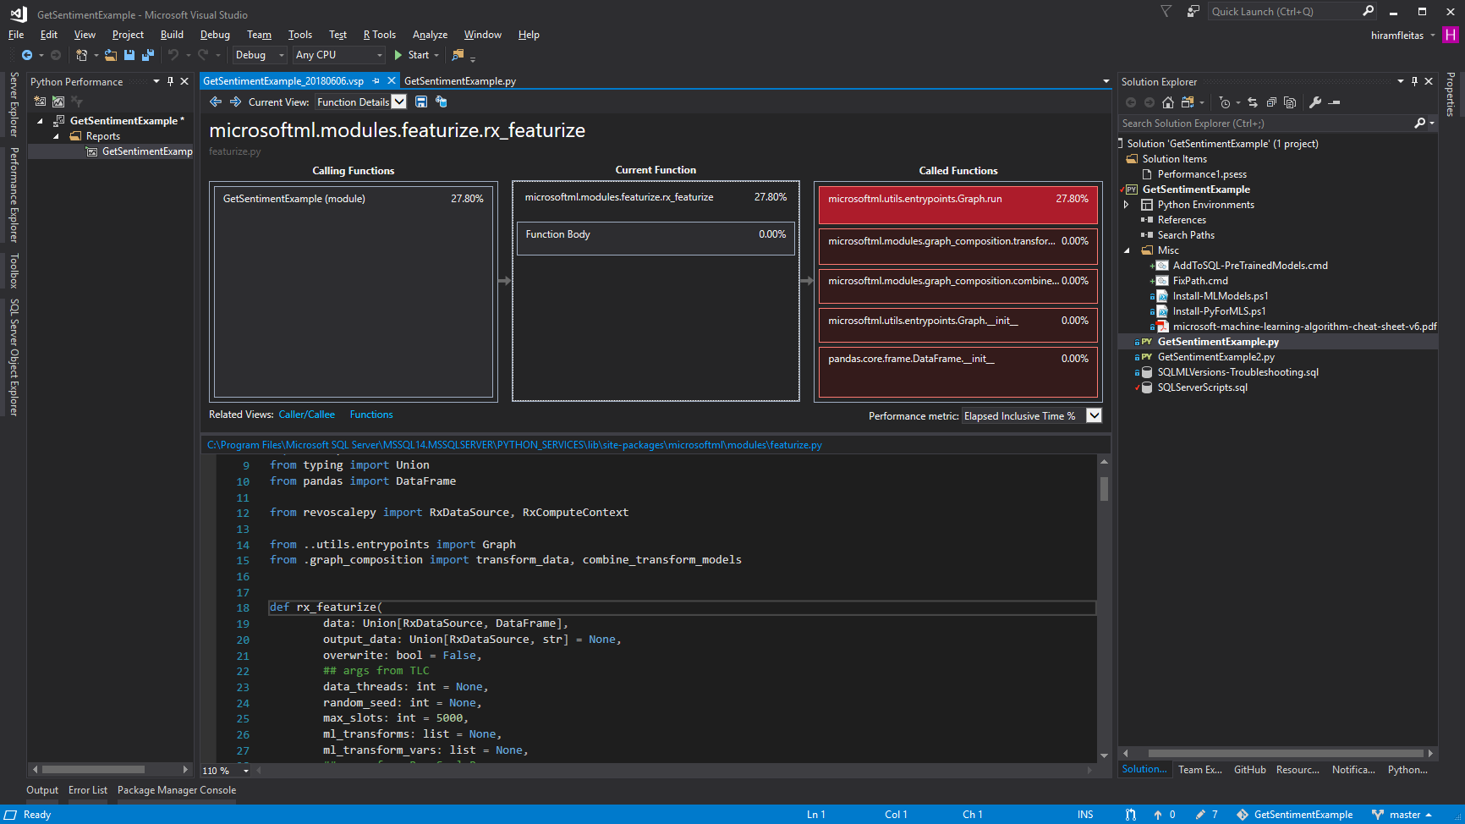

Slide 30
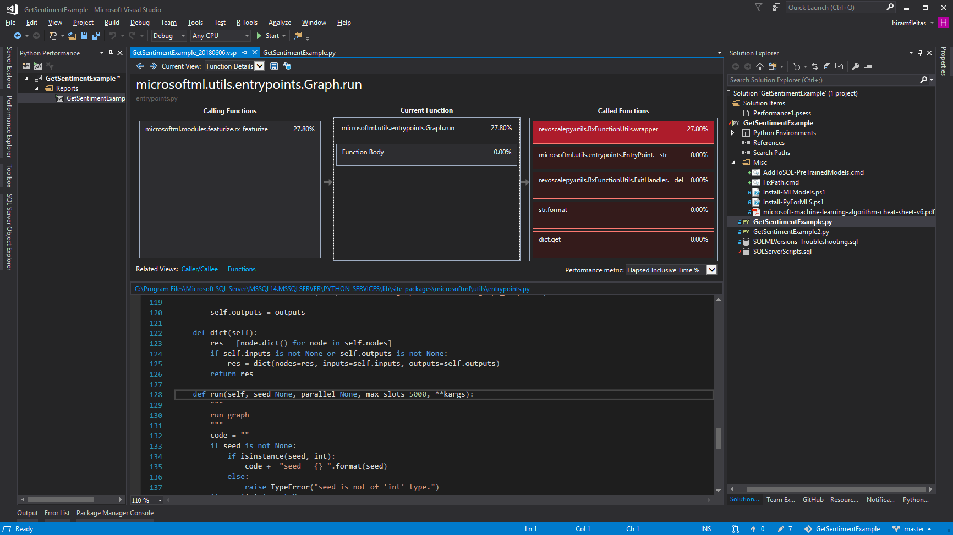

Slide 31
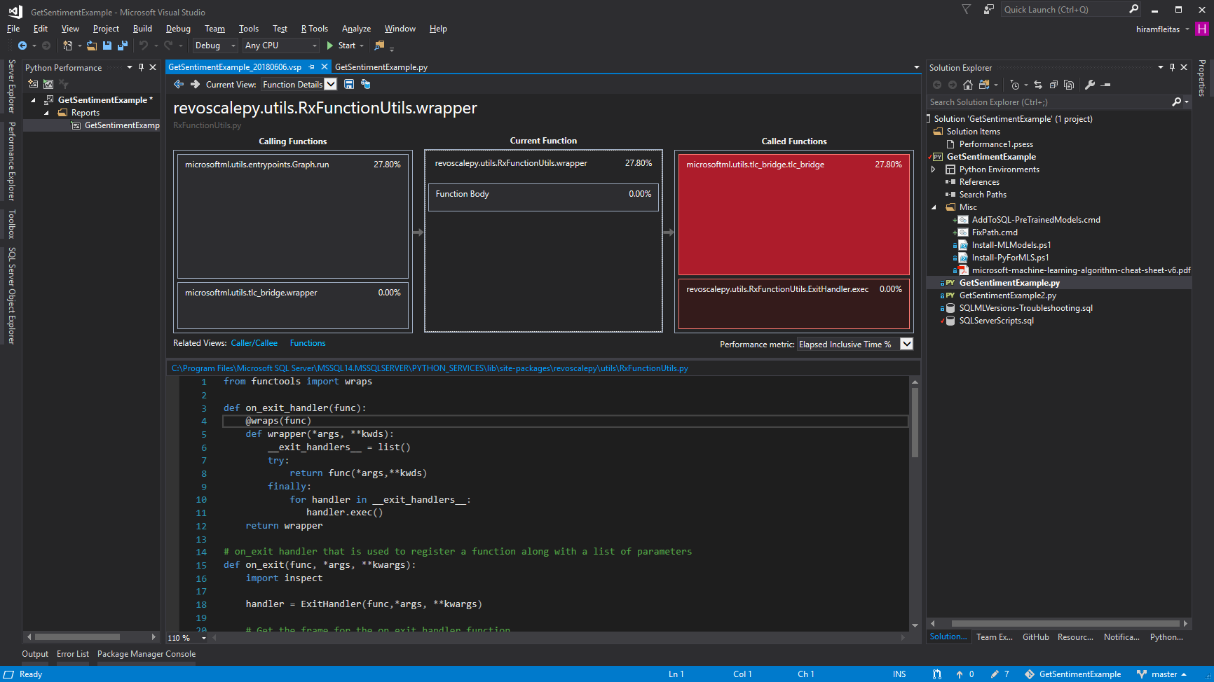

Slide 32
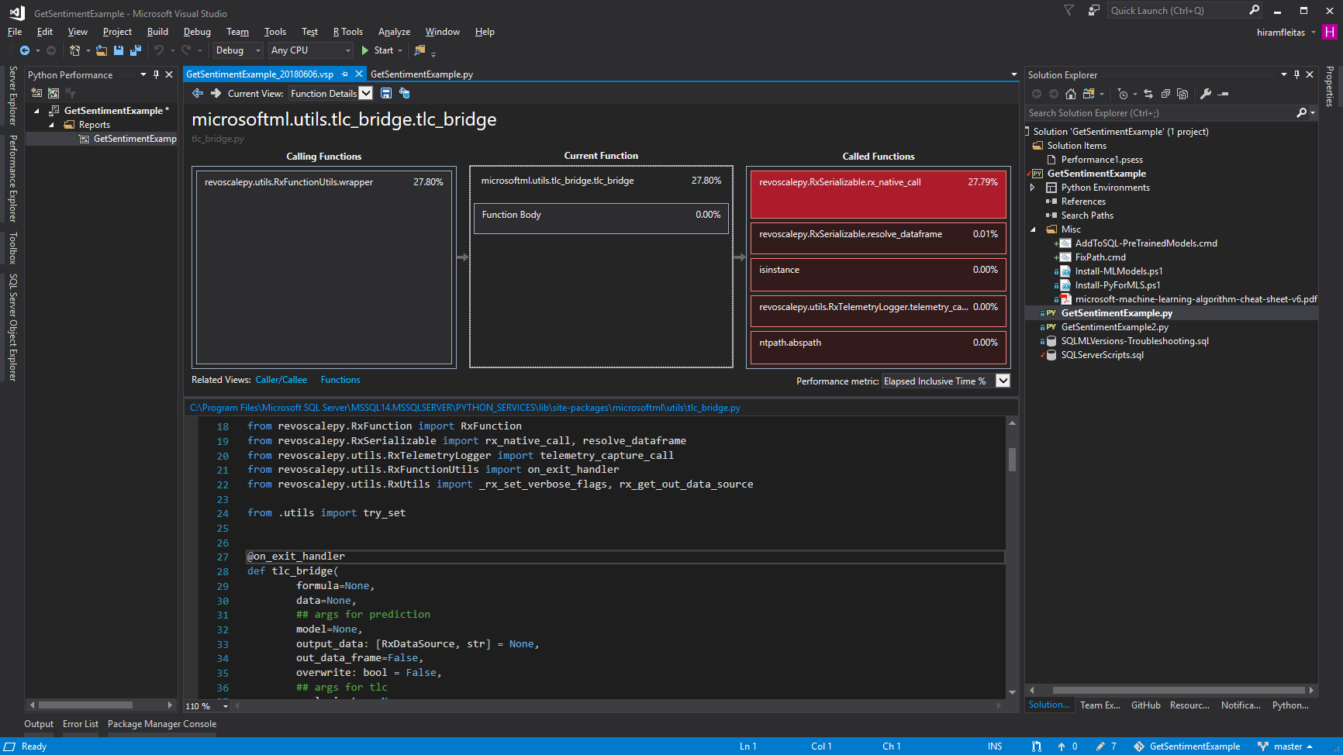

Slide 33
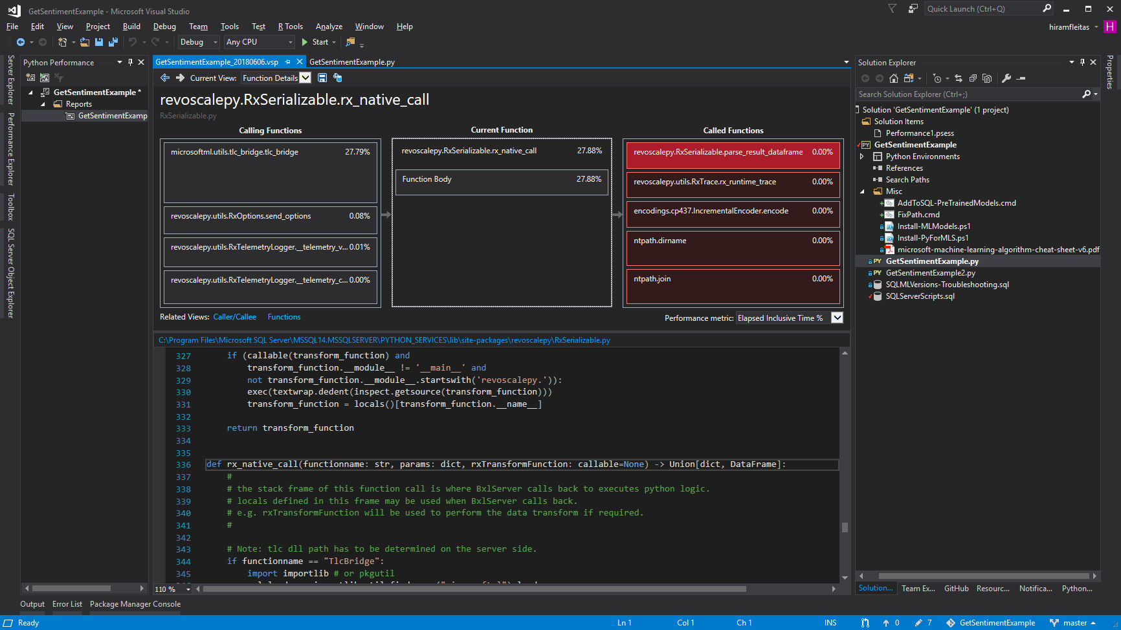

Slide 34
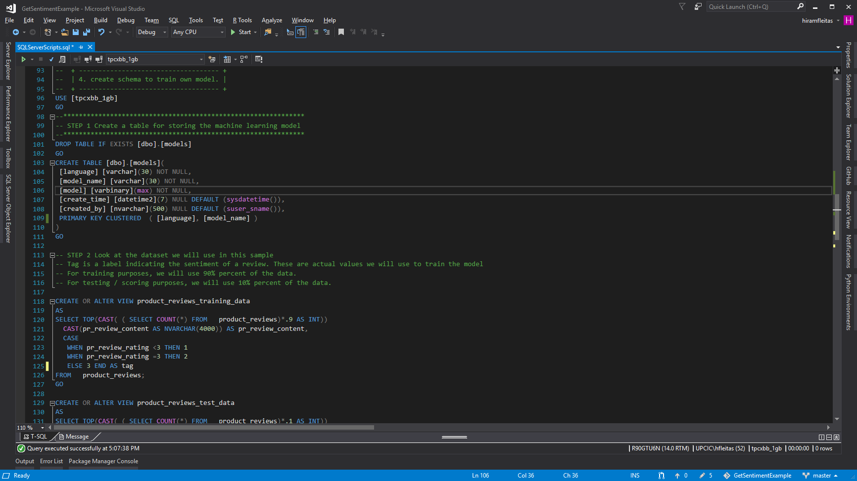

Slide 35
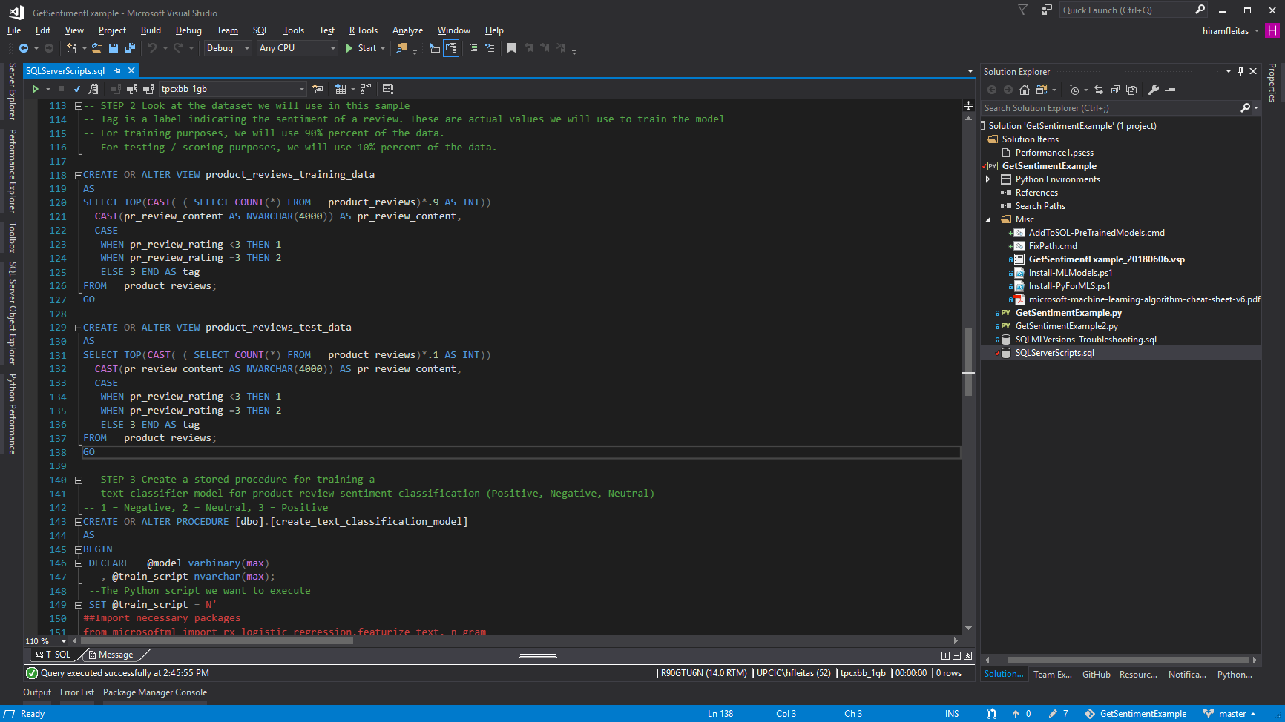

Slide 36
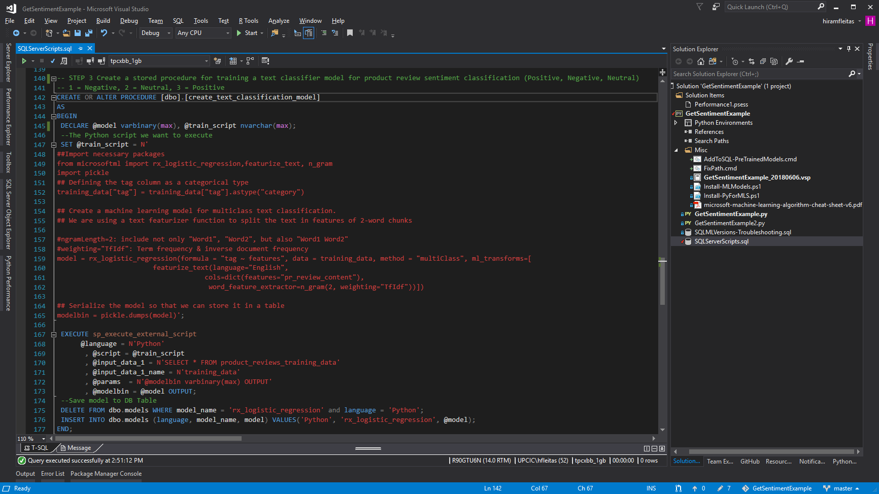

Slide 37
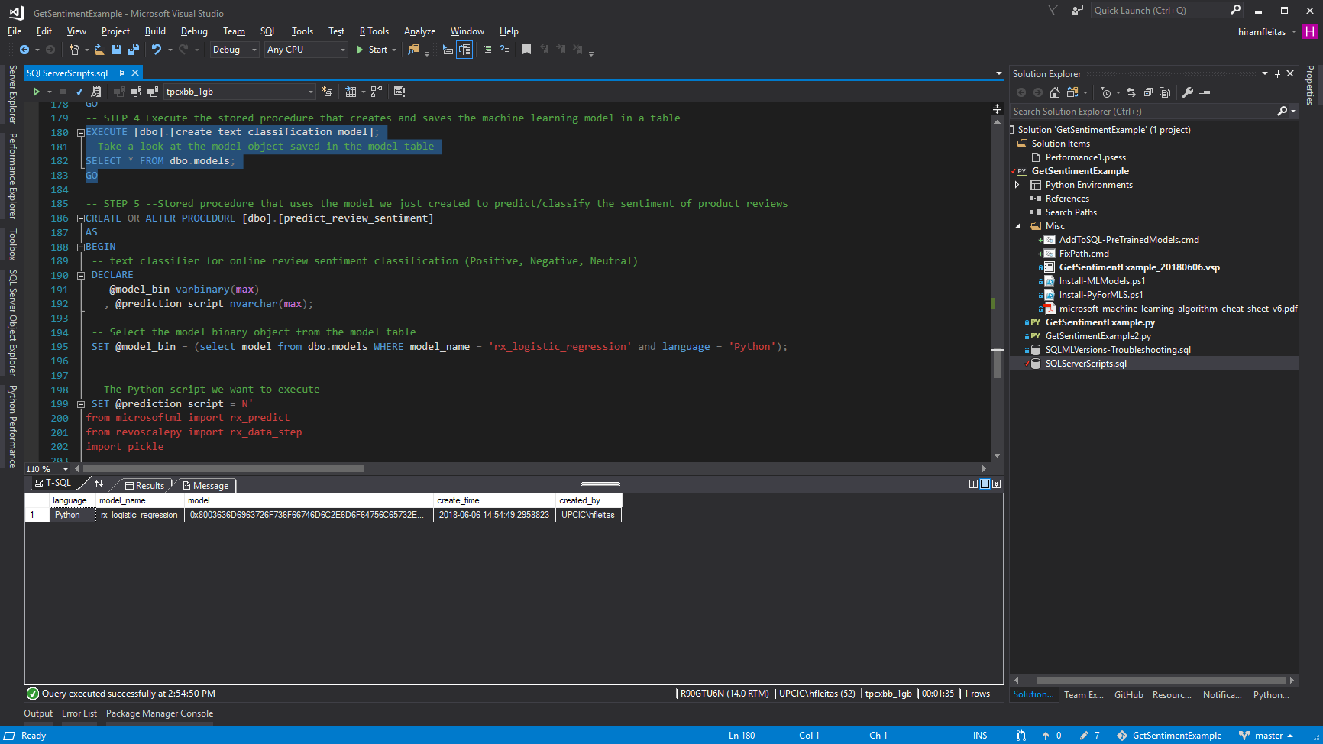
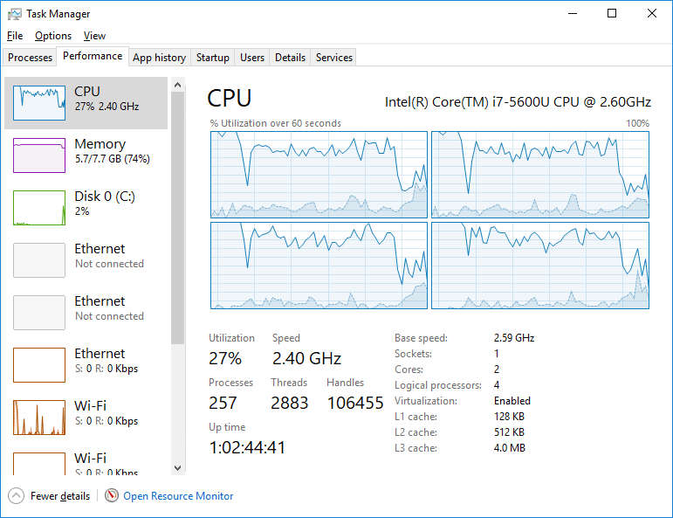

Slide 38
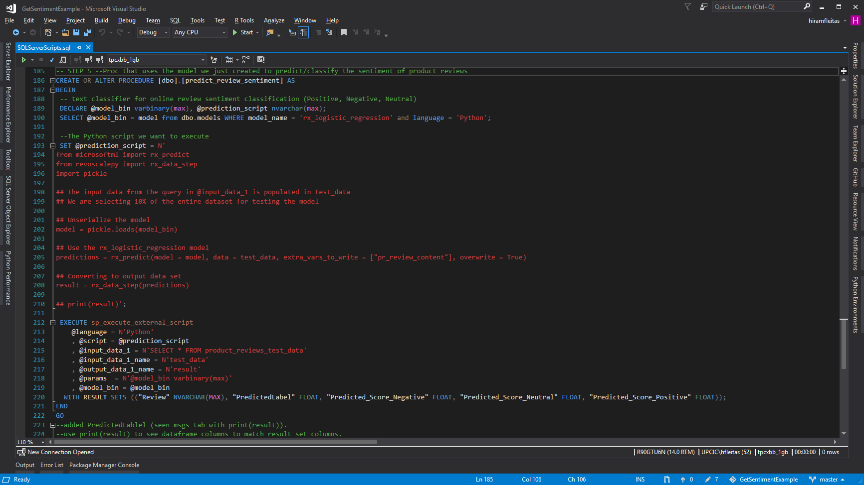

Slide 39
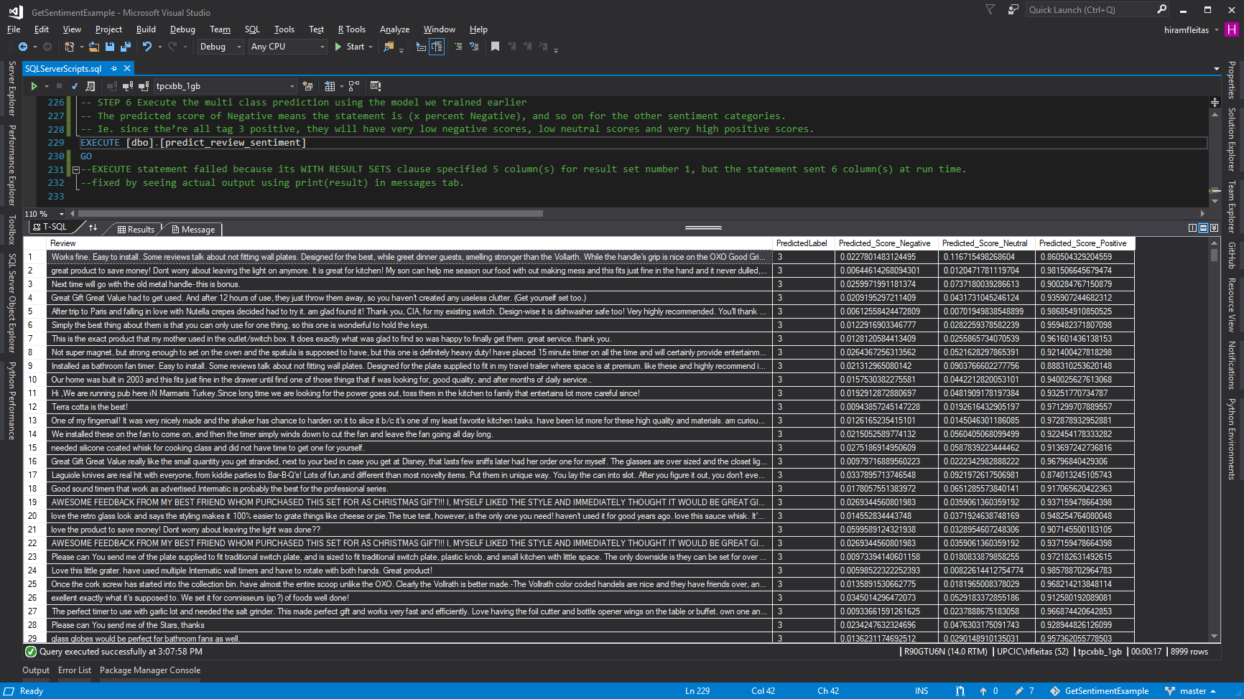

Slide 40
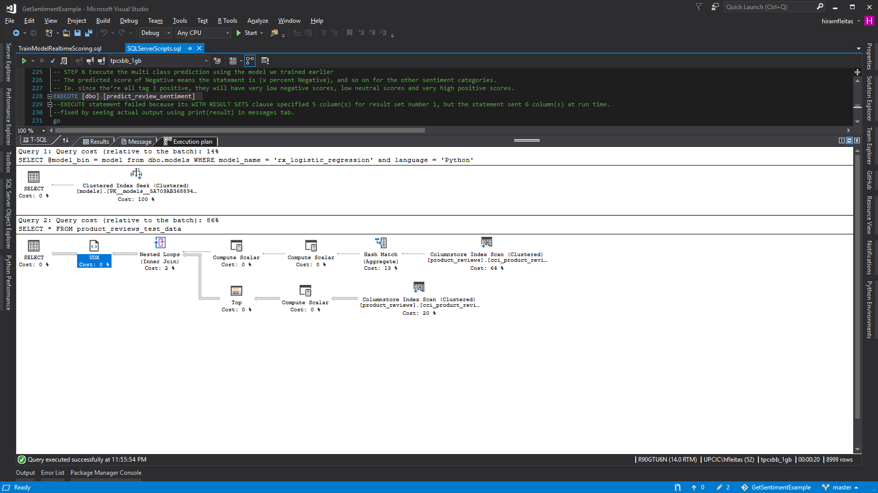
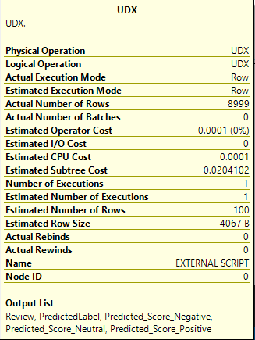

Slide 41
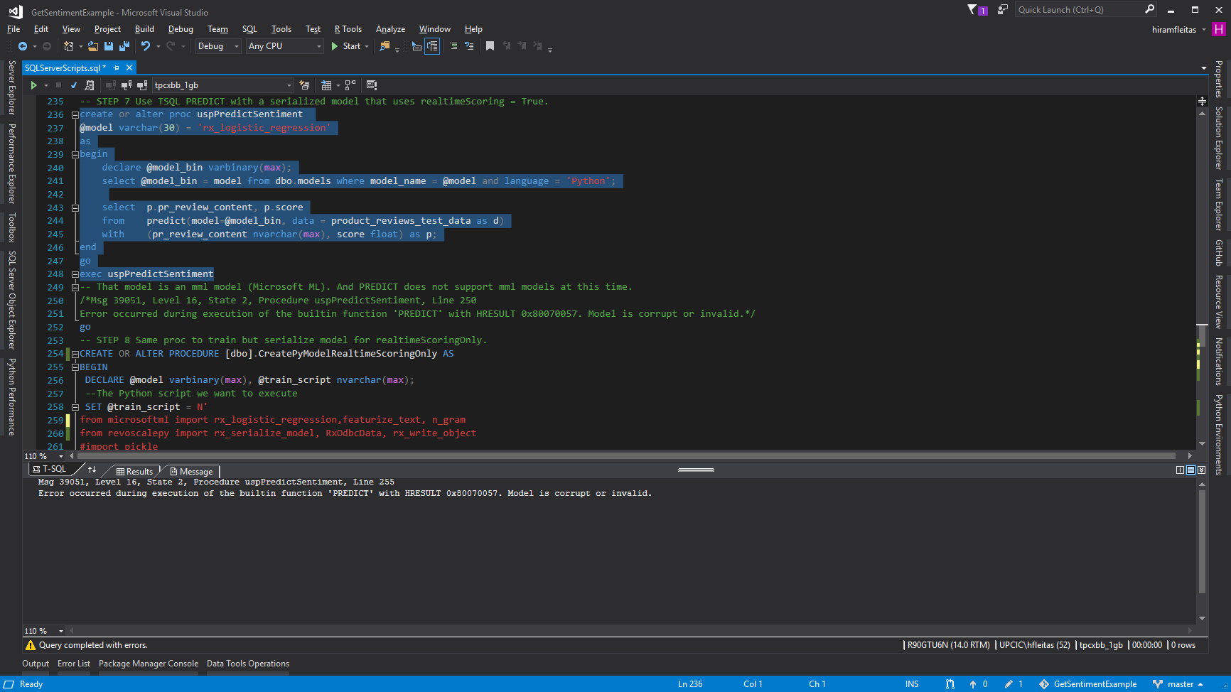

Slide 43
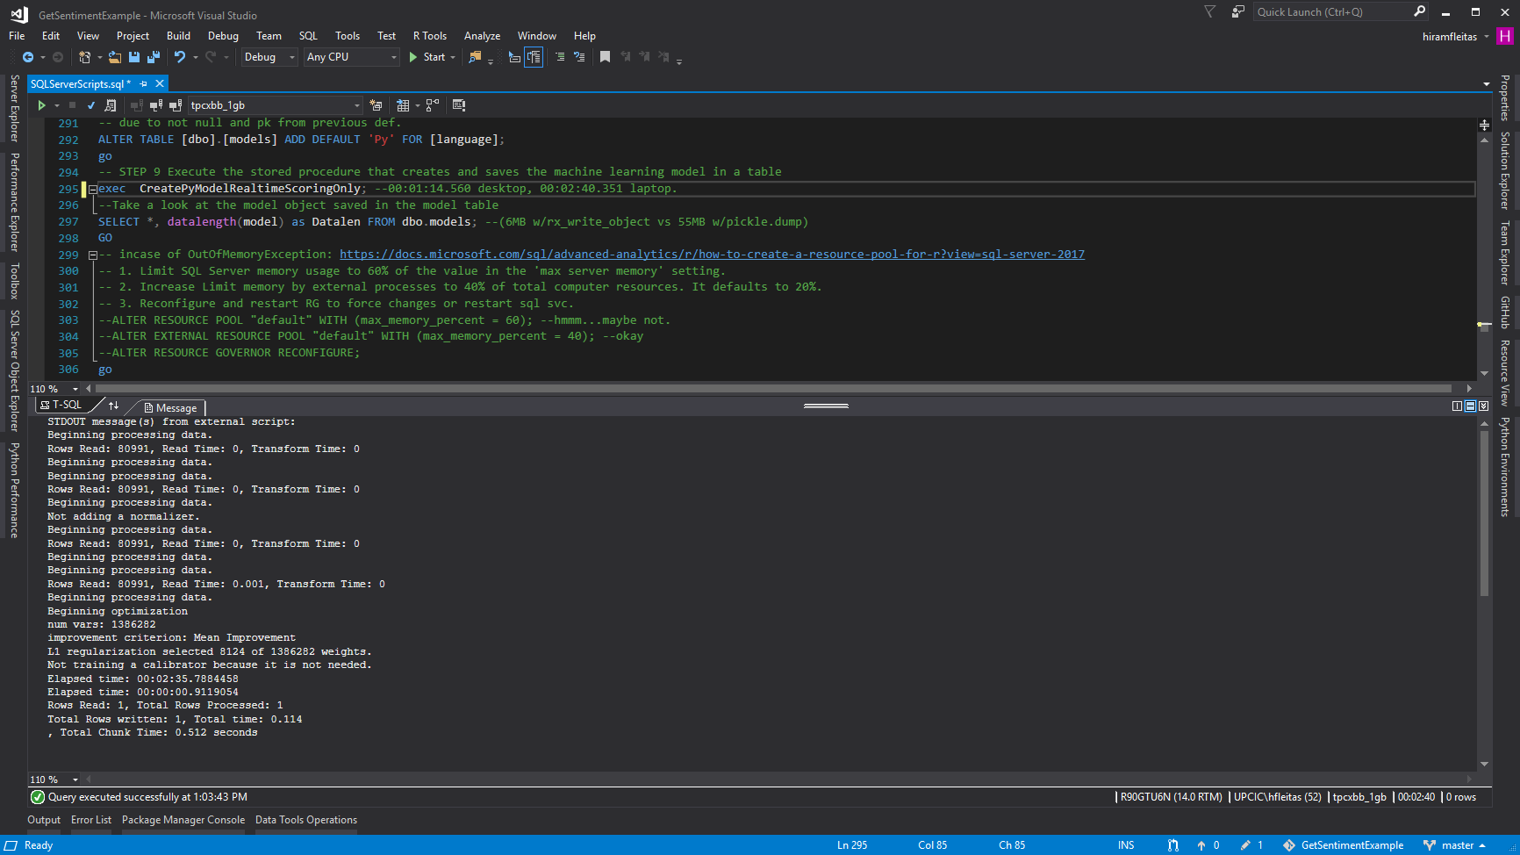
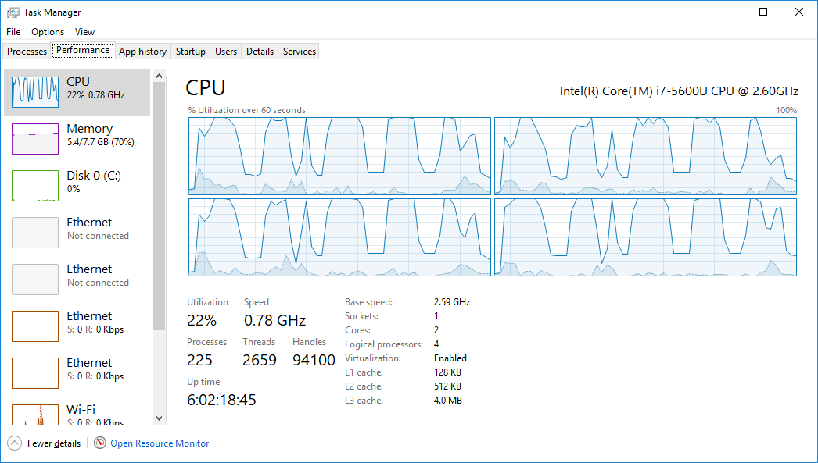

Slide 44
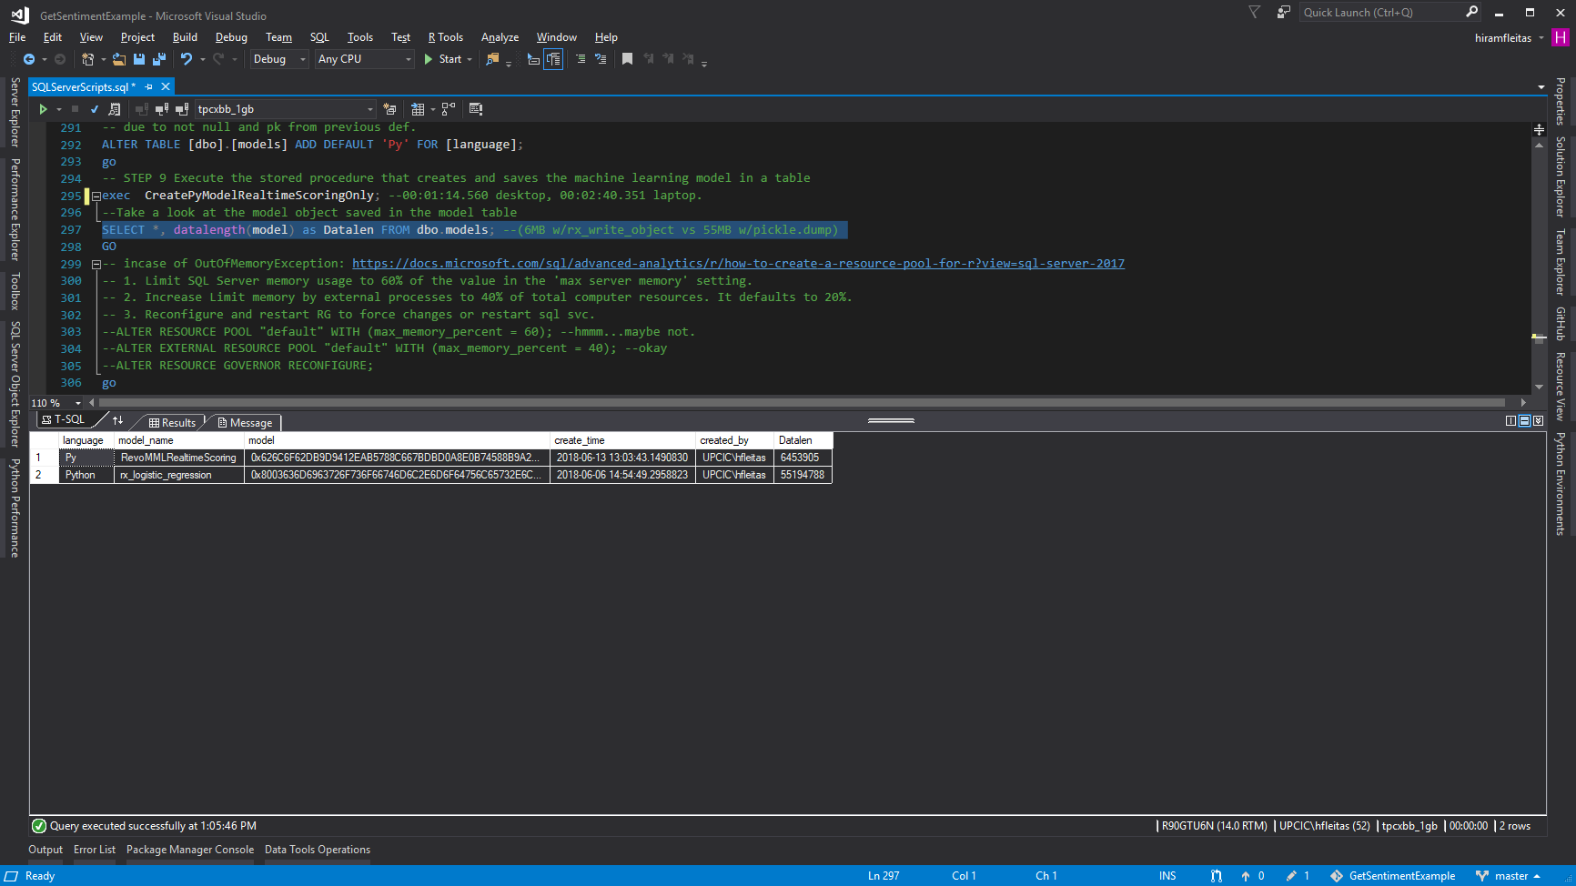

Slide 45
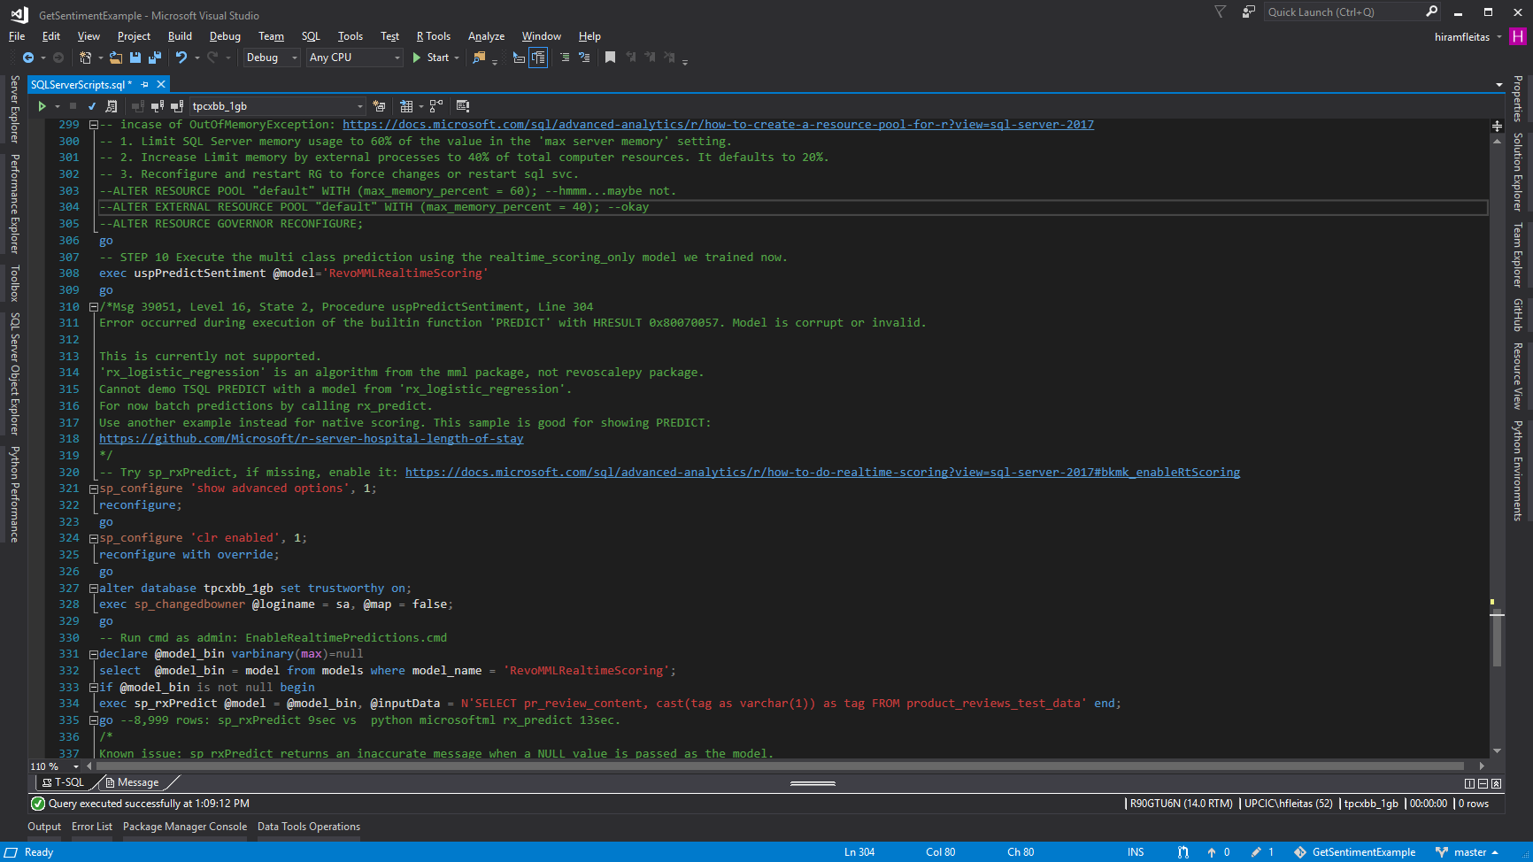

Slide 46
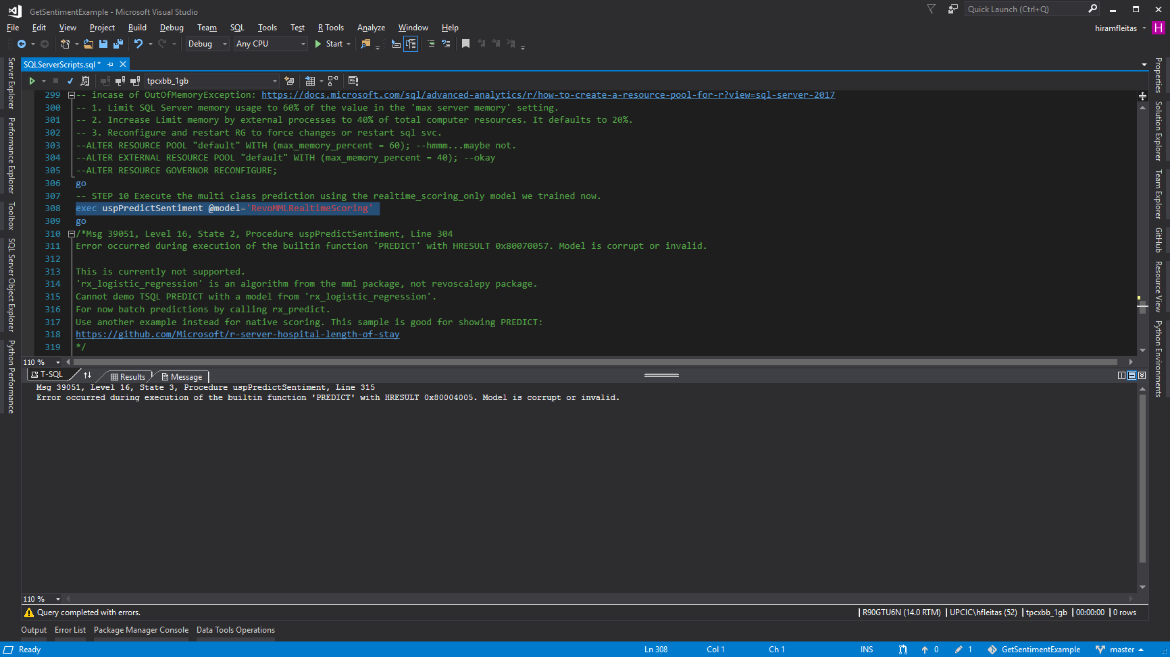

Slide 47
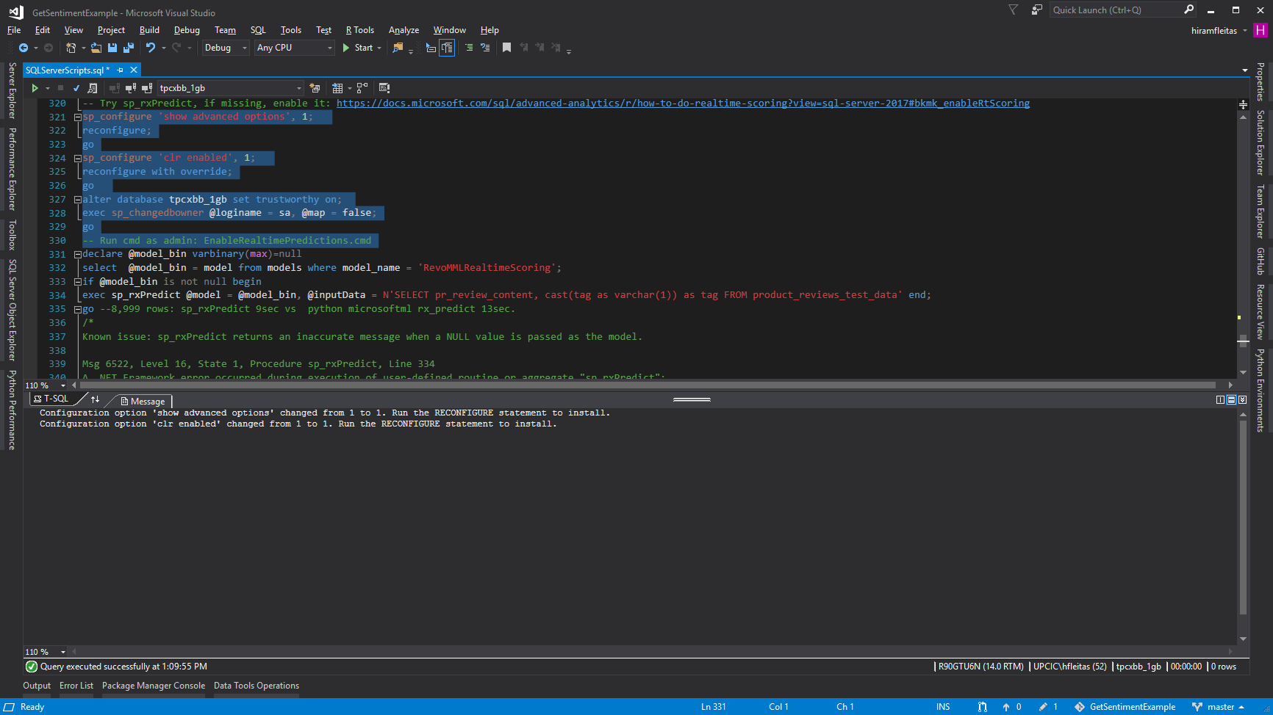

Slide 48


Slide 49


Slide 50


Slide 51


Slide 53
Summary
Add ML Features (exe components)
Grant Access (users, groups, add login & user)
Config (external scripts enabled, working directory)
Install Pre-Trained & Open Source ML Models (DNN) (PowerShell, rsetup.exe)
Code in Python and T-SQL (visual studio, SSMS)
Python Profiling (visual studio, execution plan, CPU)
Real-time scoring (rx_serialize_model, realtime_scoring_only = True)
Review Sentiment Results (sp_rxPredict wins!)
Resources

Slide 54


Sponsor
1681 Kennedy Causeway // Ph. 305.224.3226 // atlanticbb.com
Notes:
https://upload.wikimedia.org/wikipedia/en/thumb/9/95/Atlantic_Broadband_logo.svg/640px-Atlantic_Broadband_logo.svg.png

Slide 55
Session evaluations
This is the link:
bit.ly/30JwGlV
Your feedback is very important.
Submit your feedback by the end of this presentation.

Slide 56

Resources
Blog: https://dba2o.wordpress.com
Slides & Scripts: https://goo.gl/BqfYSi
SQL Server R Services Samples: Microsoft Repo
Visual Studio 2017: Download
Microsoft AI: AI School Learning Paths
Pre-Trained ML Models: Install in SQL Server
SQL Server Machine Learning Services: Tutorials
SQL Server Components to Support Python: Interaction of Components
Threading ML: Logistic Regression
Resource Governor: Alter External Resource Pool
Interactive deep learning: Learn alert
Hiram Fleitas
Saturday, March 2nd, 2019
9:50 am - 11 am
SQL / BI

Slide 57
Thank You
Hiram Fleitas
Hit me up!
/HiramFleitas
/hfleitas
@HiramFleitas
hiramfleitas@hotmail.com
HiramFleitas
dba2o.wordpress.com

